Slide 1

TED Talks
Team #6:
Nidhishree Sanam & Sravani Ravulaparthi
DATA 604: DATA MANAGEMENT
Prof. Hang Yue
May 17th 2022

Slide 2
Introduction:
TED is a global community that welcomes people from all disciplines and cultures who want to learn and spread ideas to the world in the form of short powerful talks (18 minutes or less). We are convinced that ideas have the ability to alter people's minds, lives, and, ultimately, the world. TED originated in 1984 as a conference where Technology, Entertainment, and Design converged, and has since expanded to embrace nearly every topic imaginable, from science to business to global challenges, in over 100 languages. So, we have chosen this data to analyze more about the ted talk shows.

Slide 3
Things we Can analyze ?
Finding the most popular TED talks based on Views & Likes.
Finding the most popular TED talks Speaker (in terms of number of shows).
Finding the less popular ted talks based on Views & Likes.
Month-wise analysis of TED talk frequency.
Year-wise analysis of TED talk frequency.
Popular shows in recent times (2020 to 2022).
Shows with more than one Speaker.
Author occupation has any correlation with the Likes & Views.
Number of shows with same author occupation.
Avg number of Likes & Views per year.
Number of shows based on number of speakers.

Slide 4
Project Flow:
Collected data and divided the big data into two tables (tedshows, tedauthor).
Figured out relationships among data tables via Entity-Relationship diagram.
Loaded data files into AWS S3 bucket, later created database with S3 location in AWS Glue.
Created and Run the crawler to extract the tables from the data files.
SQL codes will be written to query the data to check the popular shows based on the views & likes, to find most popular Ted talk speaker, Month & Year-wise Ted shows frequency using SQL Joins via Athena.
We have also created an AWS RDS, and connected it with MySQL workbench for querying the data from the tables.
Using this cleaned data, we have connected to Tableau to perform the data analysis and display the important information using graphs.

Slide 5



Tools Used
AWS S3 Bucket: To load the csv files into the cloud storage and to store all the output files in the cloud
AWS RDS: To host the MySQL
AWS Glue: To access the data and create table definitions
AWS Athena: To analyze data in Amazon S3 using standard SQL
Tableau: For Visualization and Analysis

Slide 6

Yearly Technical Cost Estimation
AWS Server and Storage costs: ~$35,000
DBMS Administrator Salary if hired- ~$80,000-90,000
Tableau: ~$1000

Slide 7
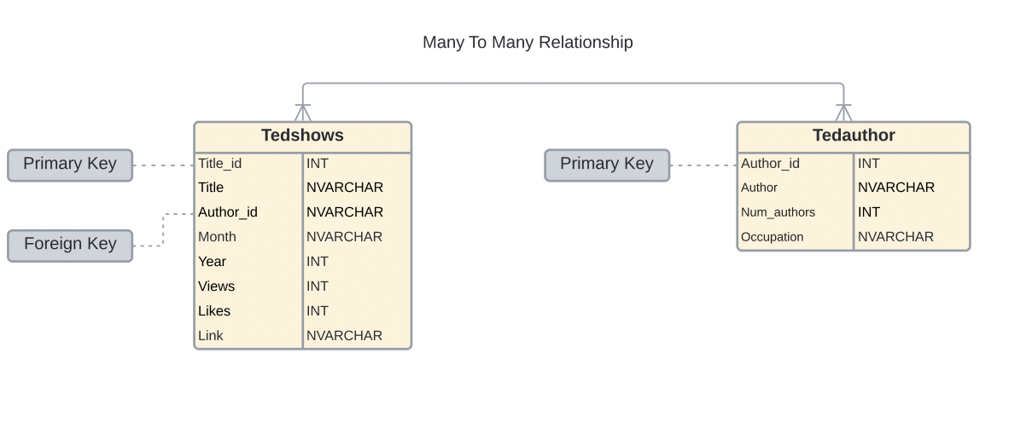
Entity Relationship-Diagram

Slide 8
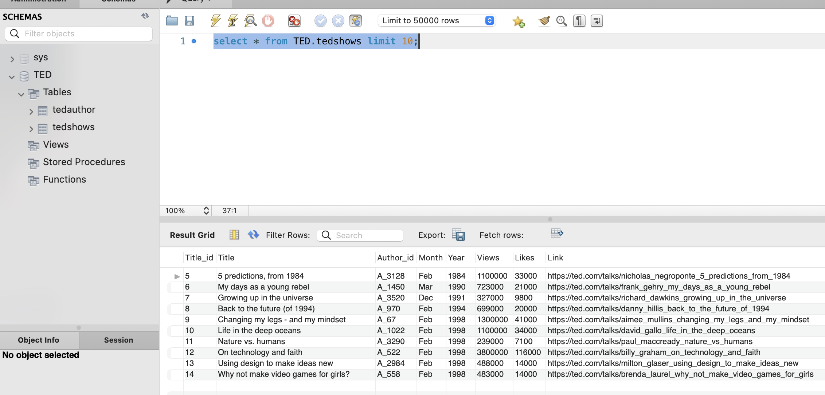
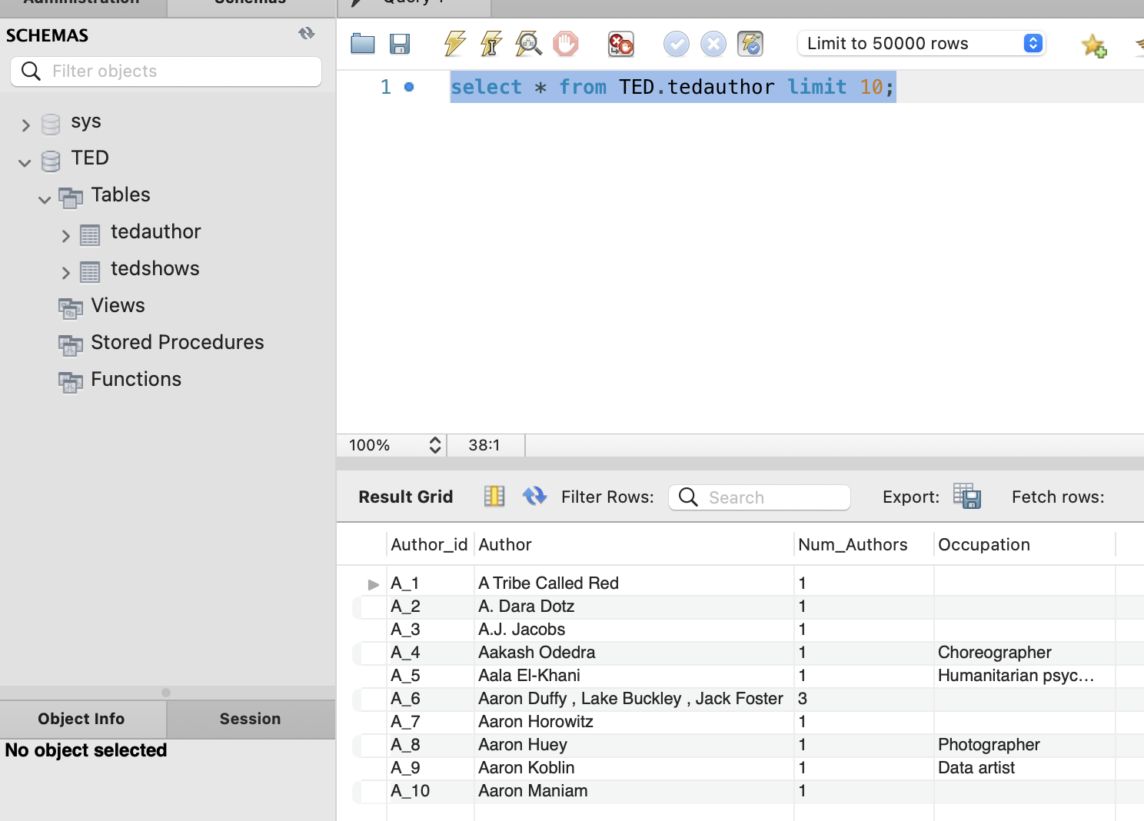
DATA TABLES
Ted_shows :
Columns- Title_id, Title ,author_id, Month, Year, views, likes, link
In this table, title_id serves as a primary key.
Ted_Author:
Columns: Author_id, author, Num_authors, Occupation.
Author_id serves as a unique identifier.

Slide 9
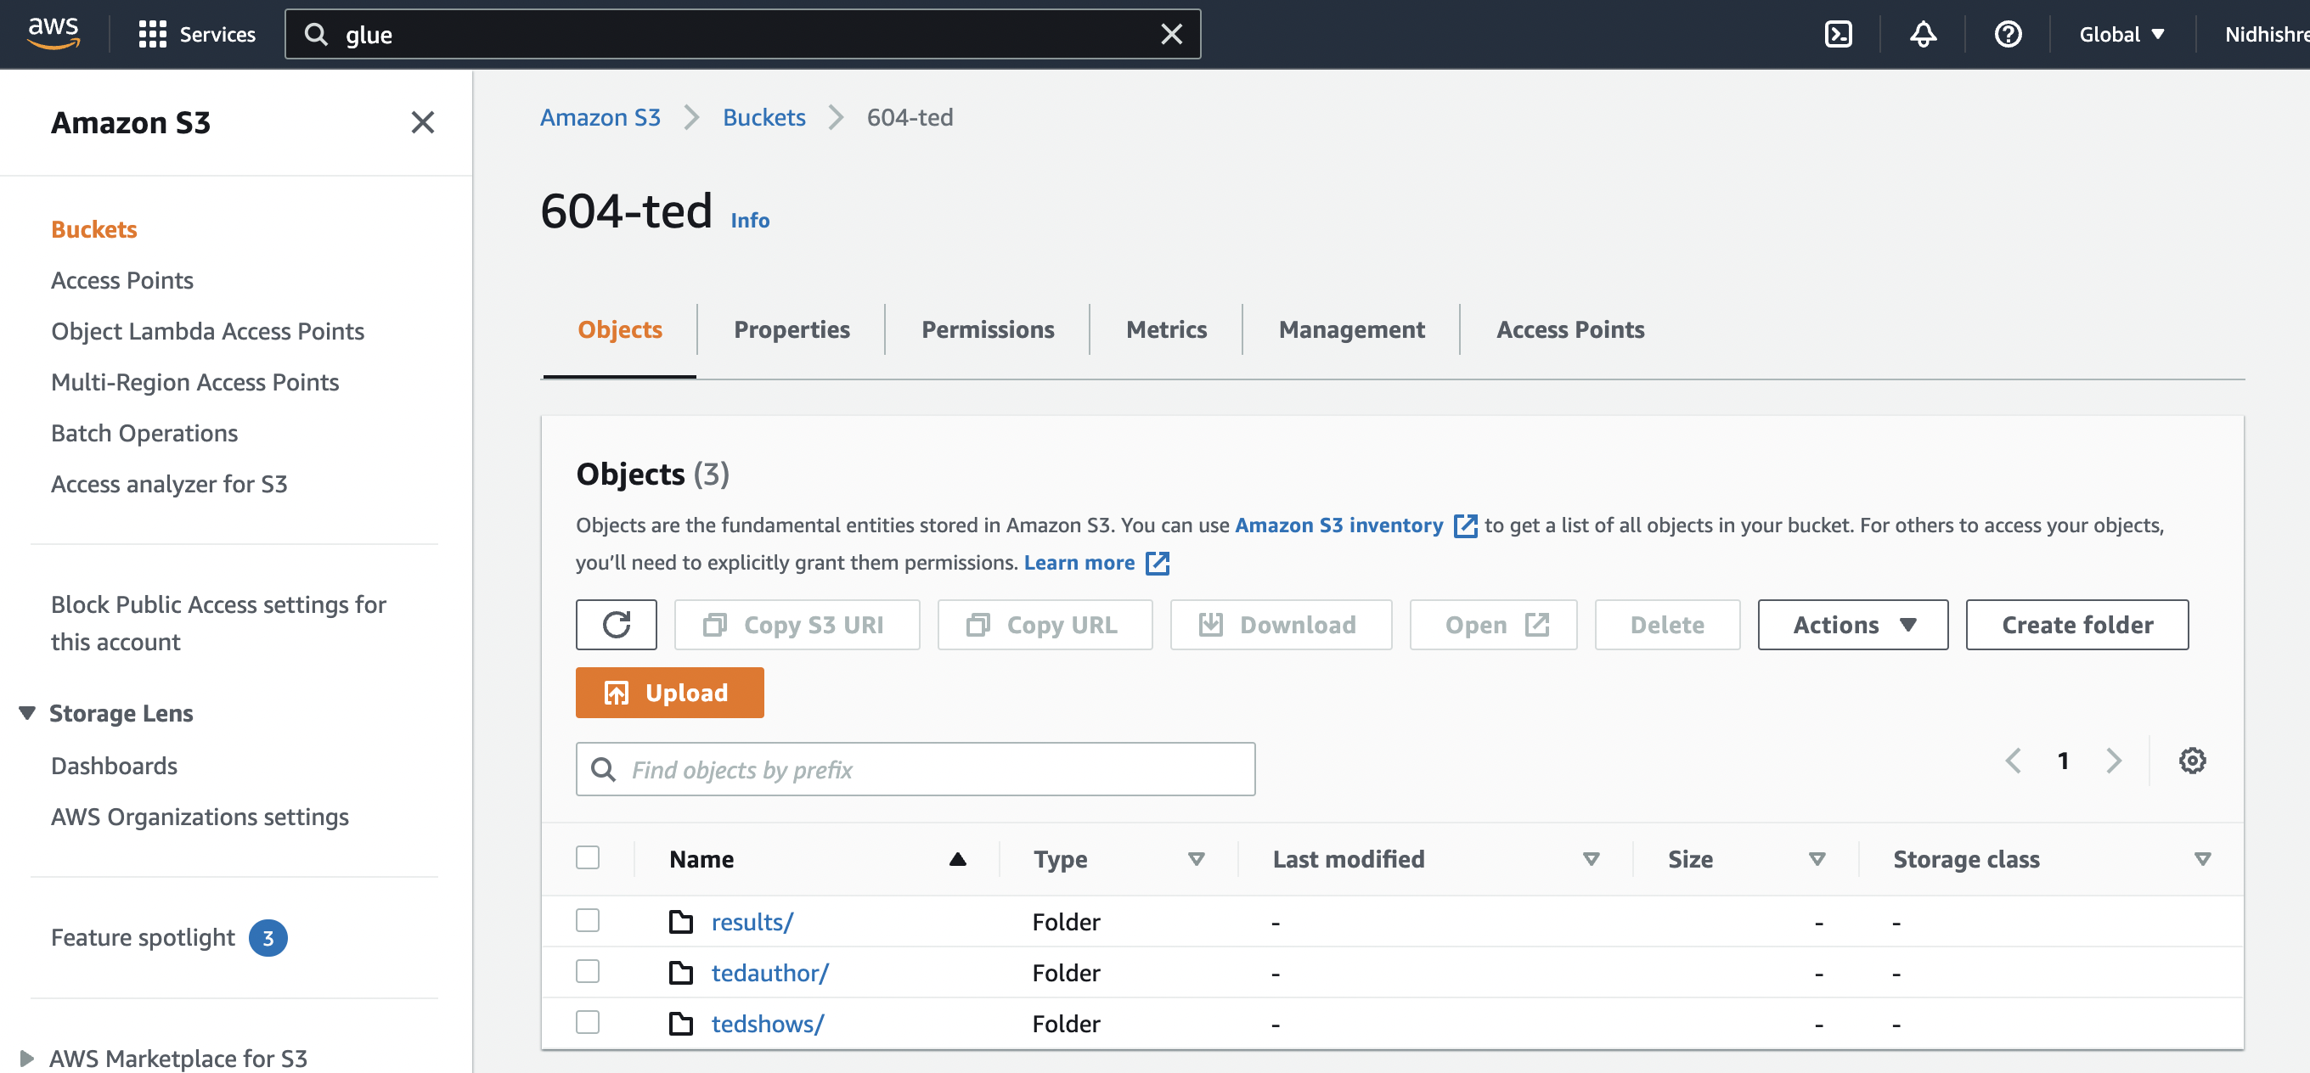
AWS S3 Bucket:

Slide 10
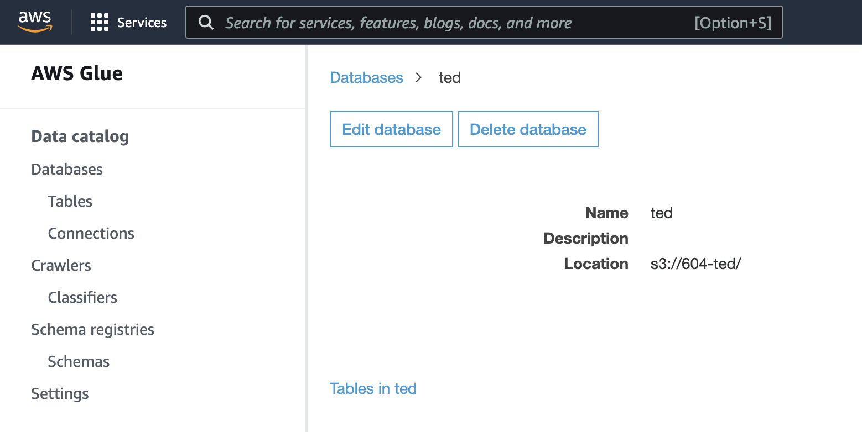
AWS Glue

Slide 11
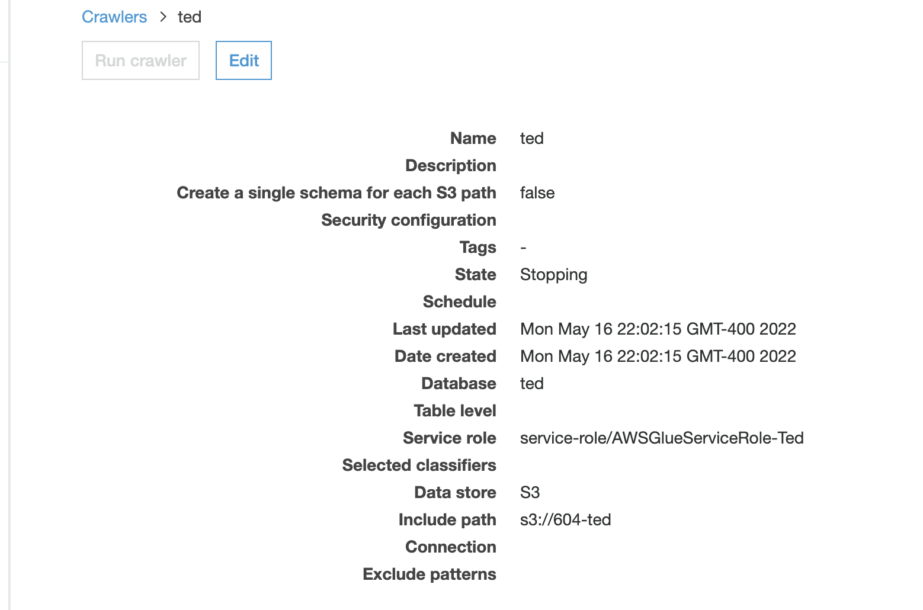
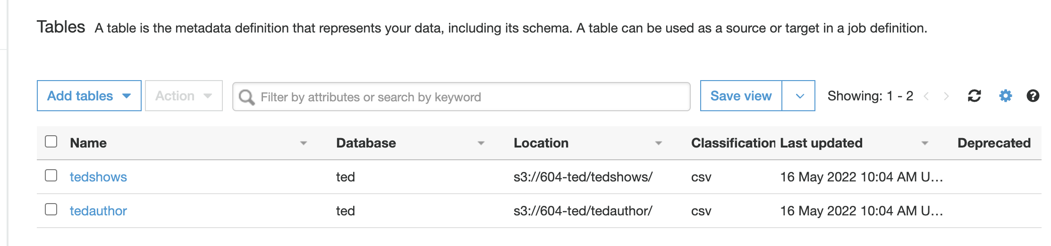
CRawler

Slide 12
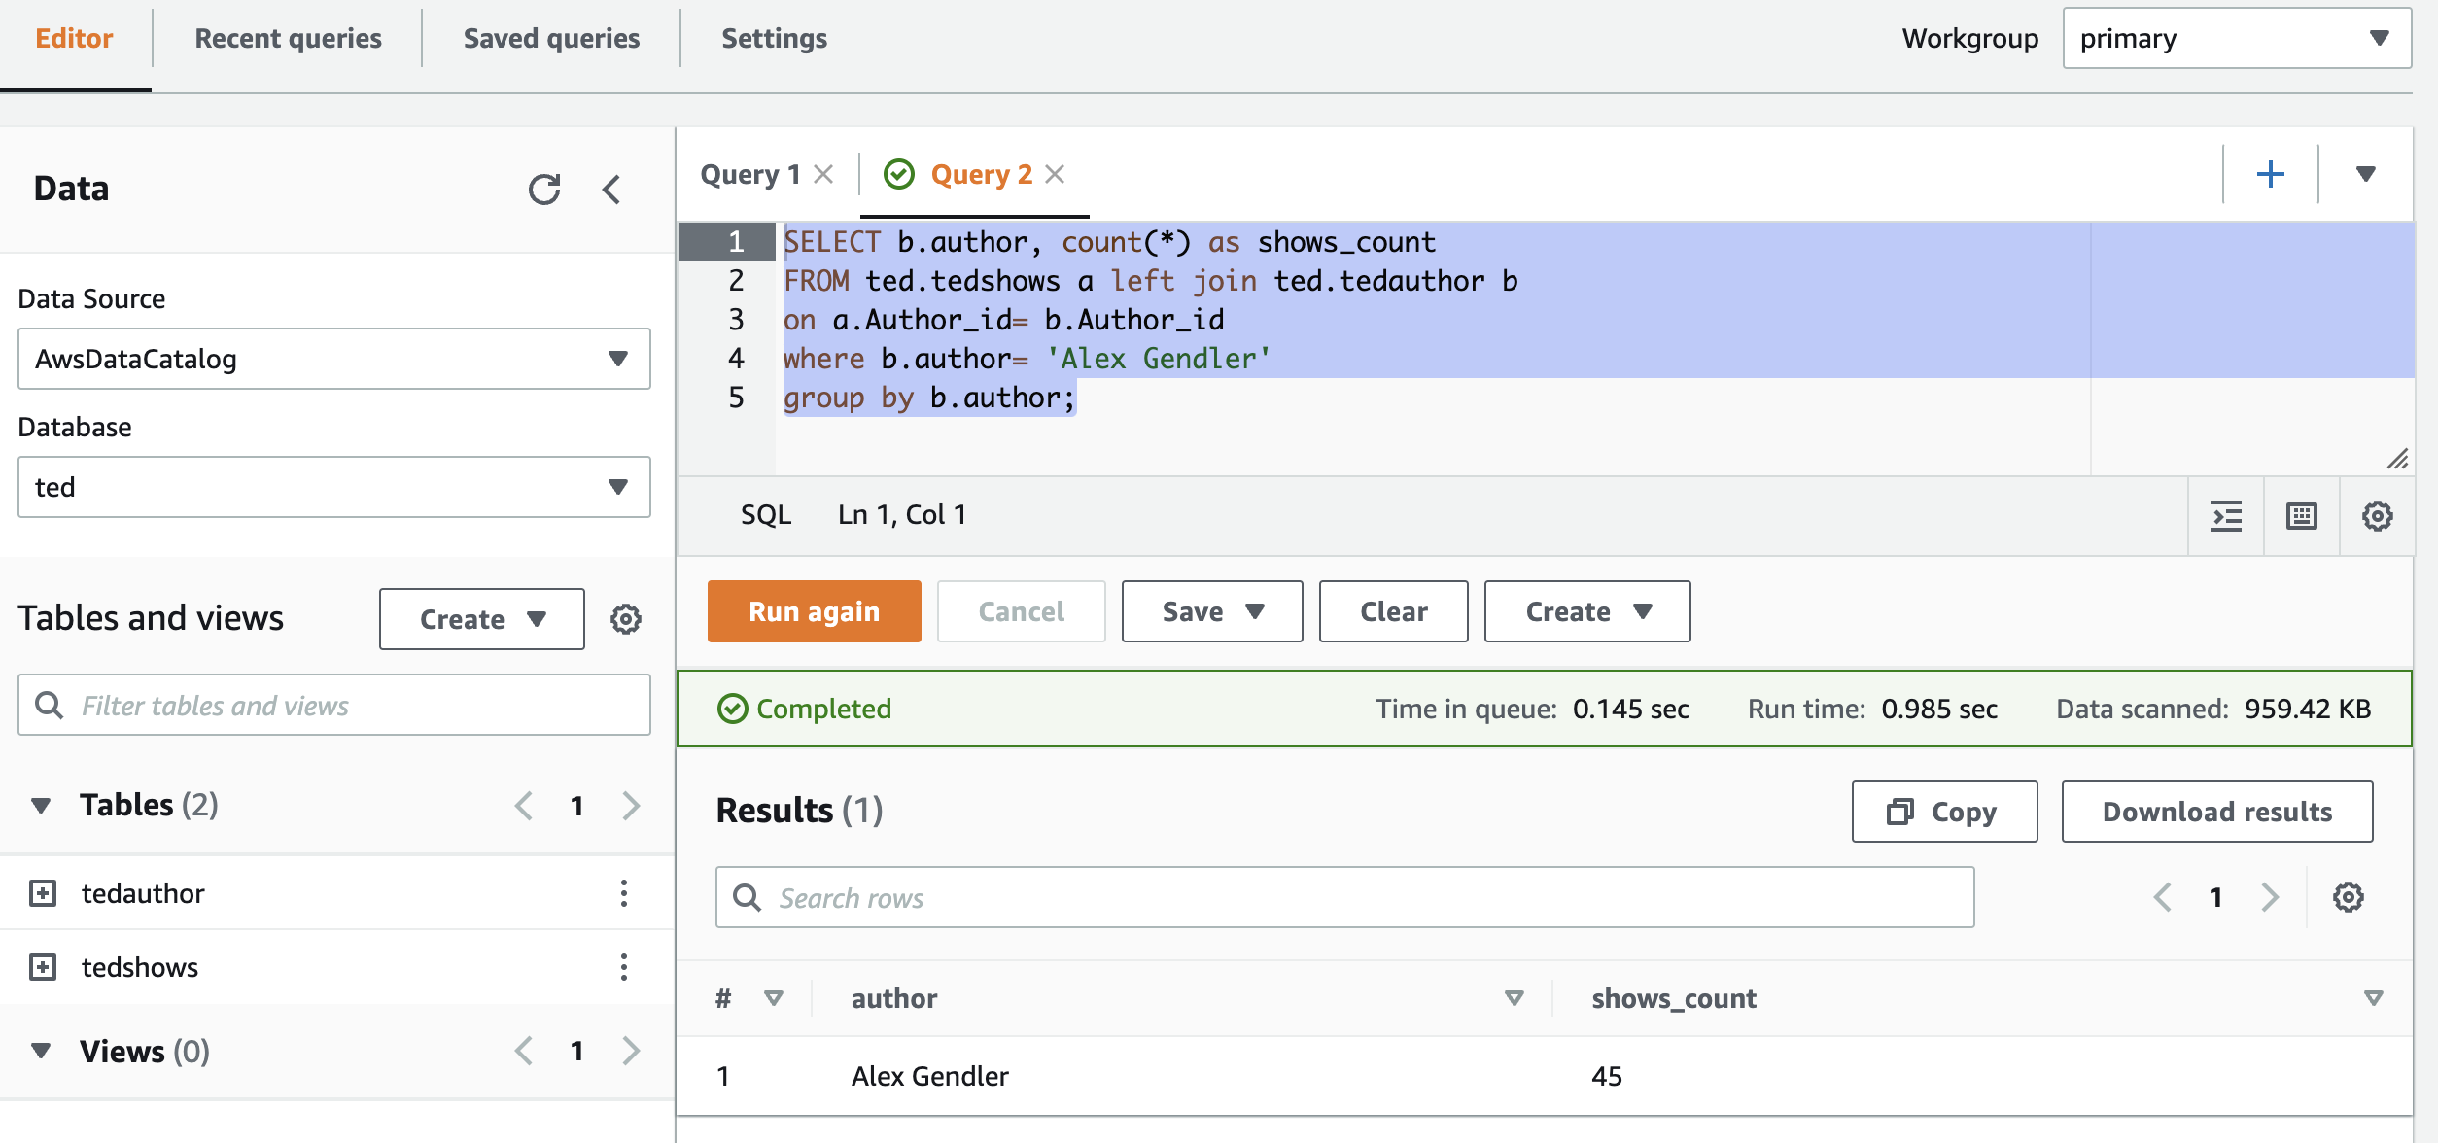
AWS Athena

Slide 13
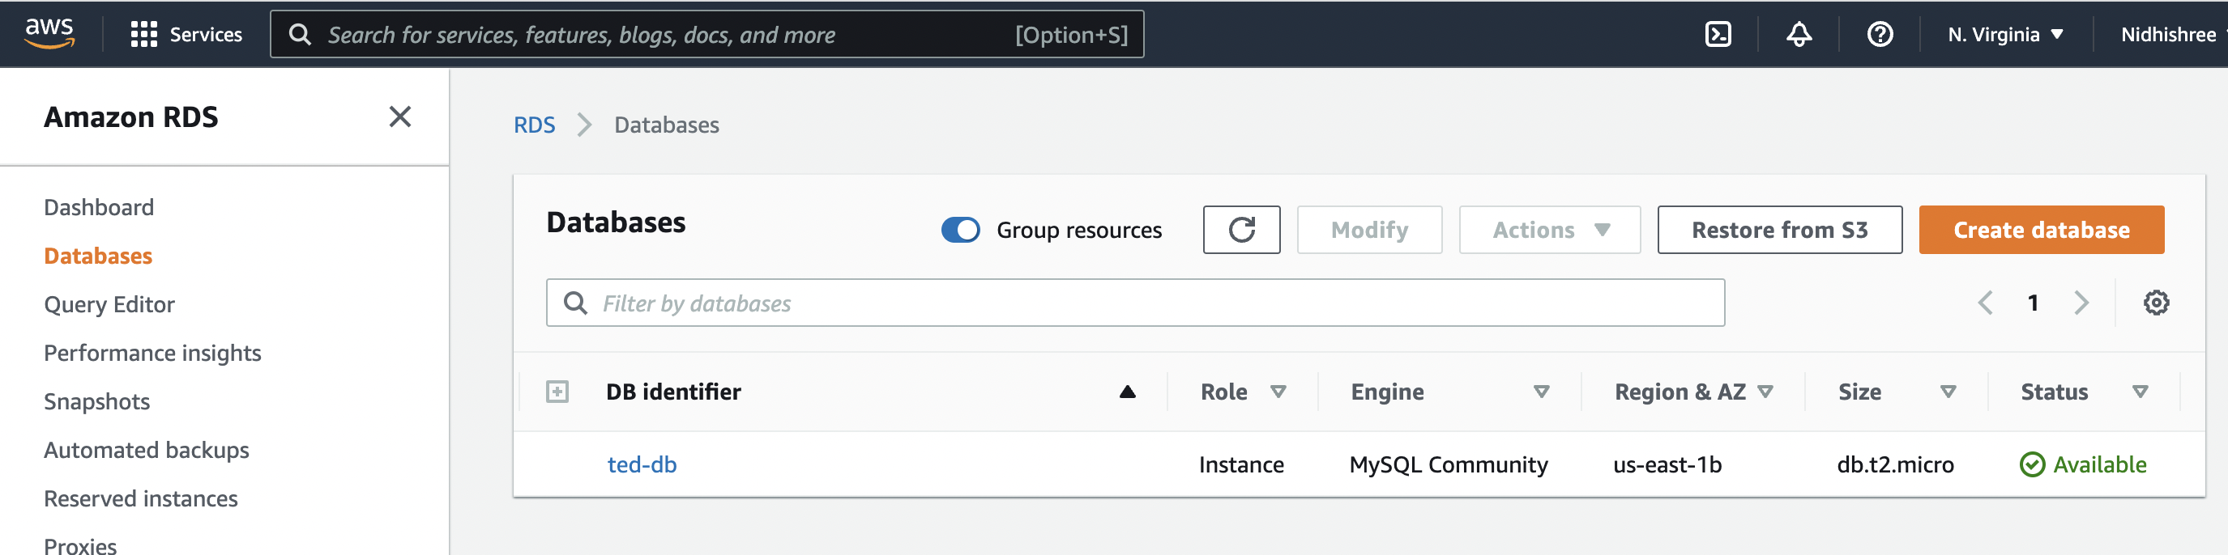
AWS RDS

Slide 14
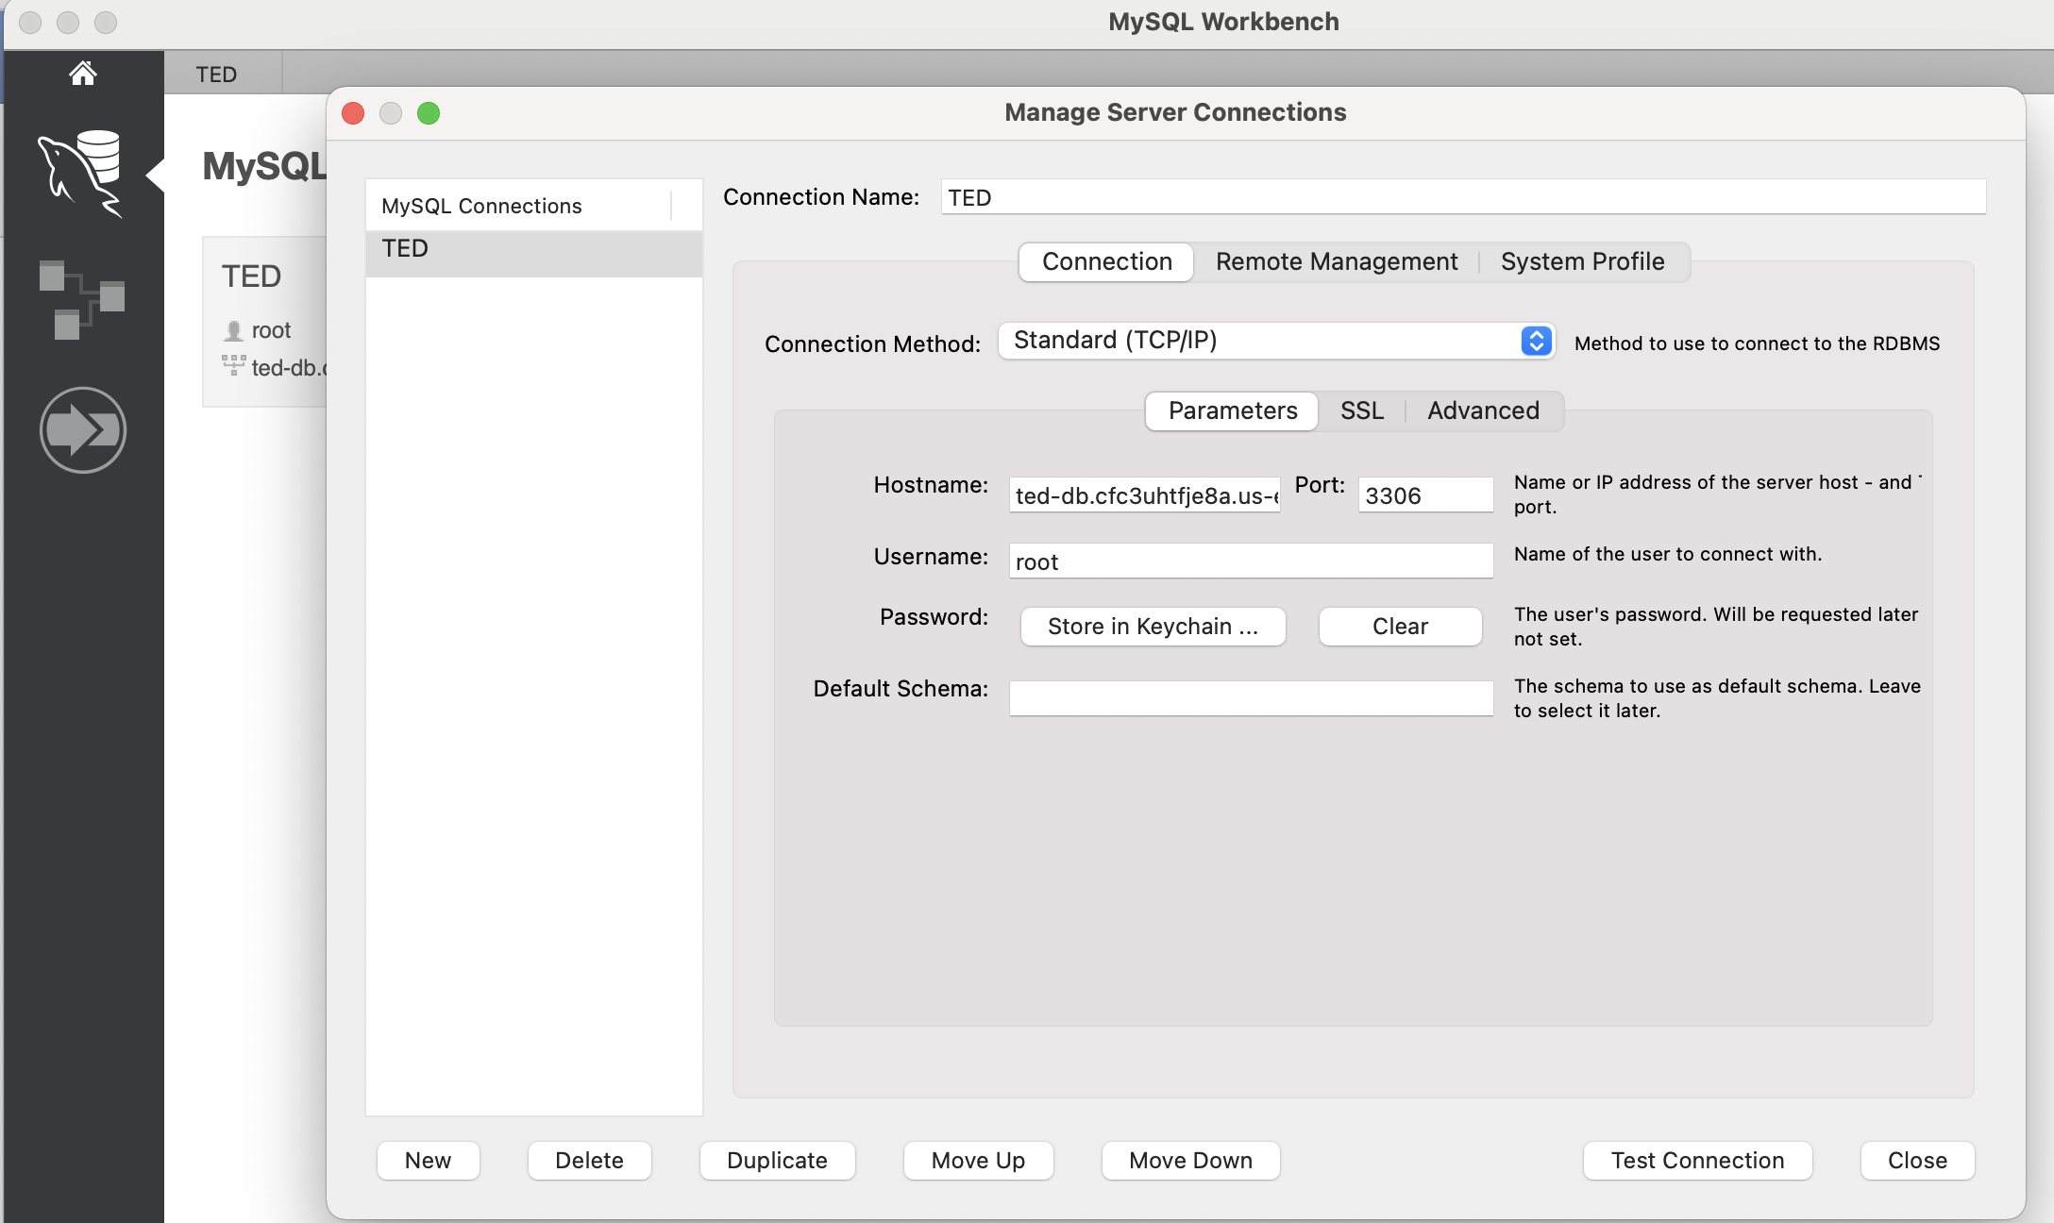
Connecting AWS RDS Through Mysql workbench

Slide 15
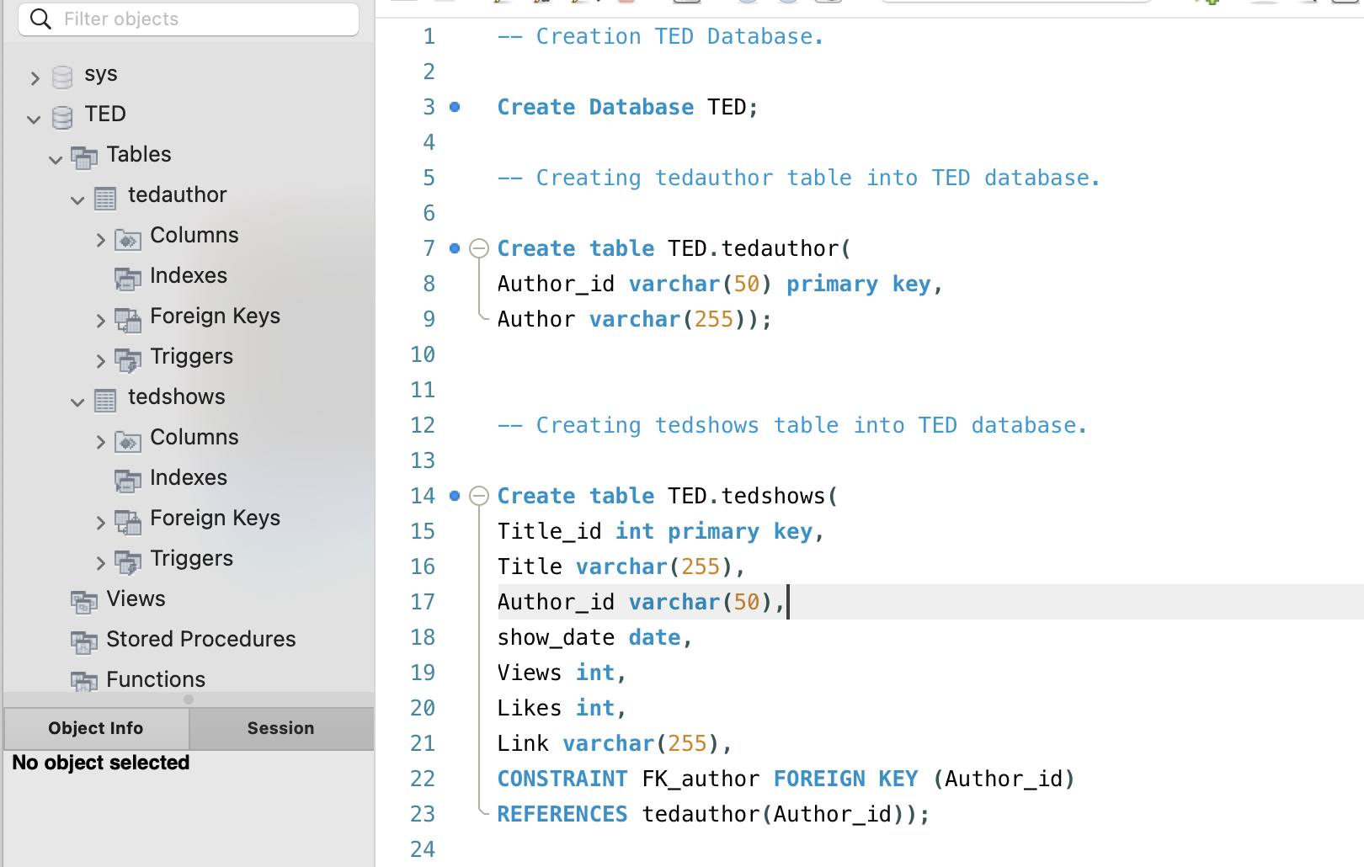
CREATED TED Database, Tables

Slide 16
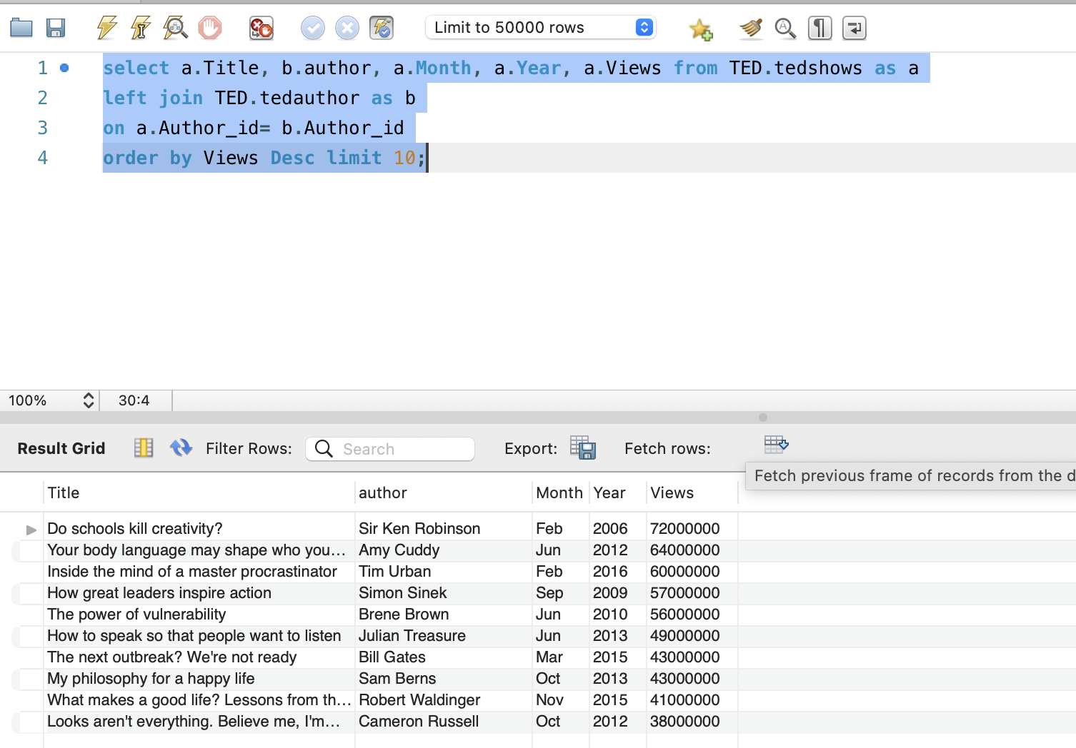
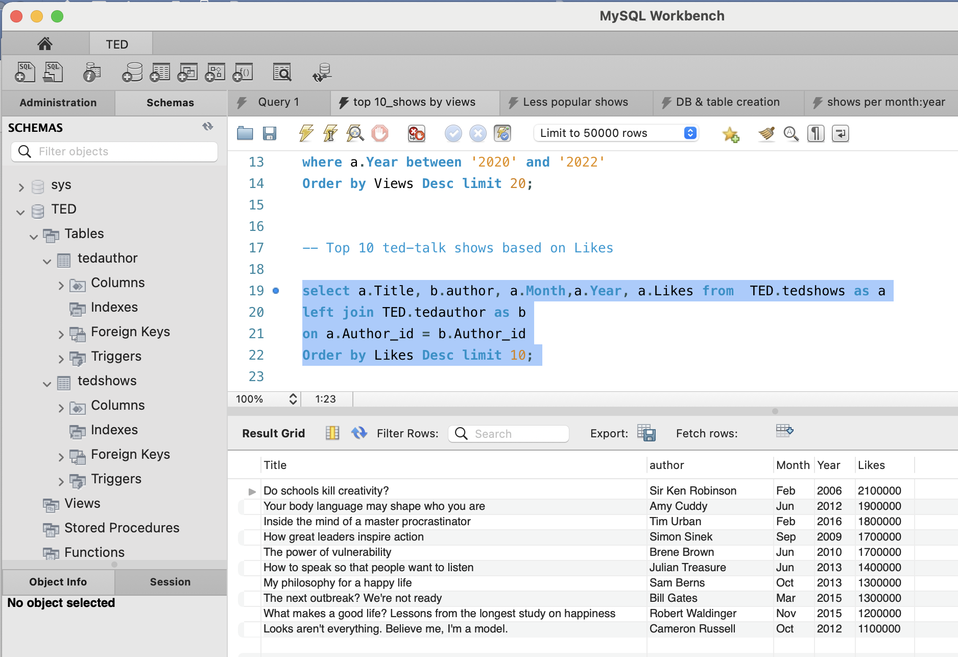
SQL Queries:

Slide 17
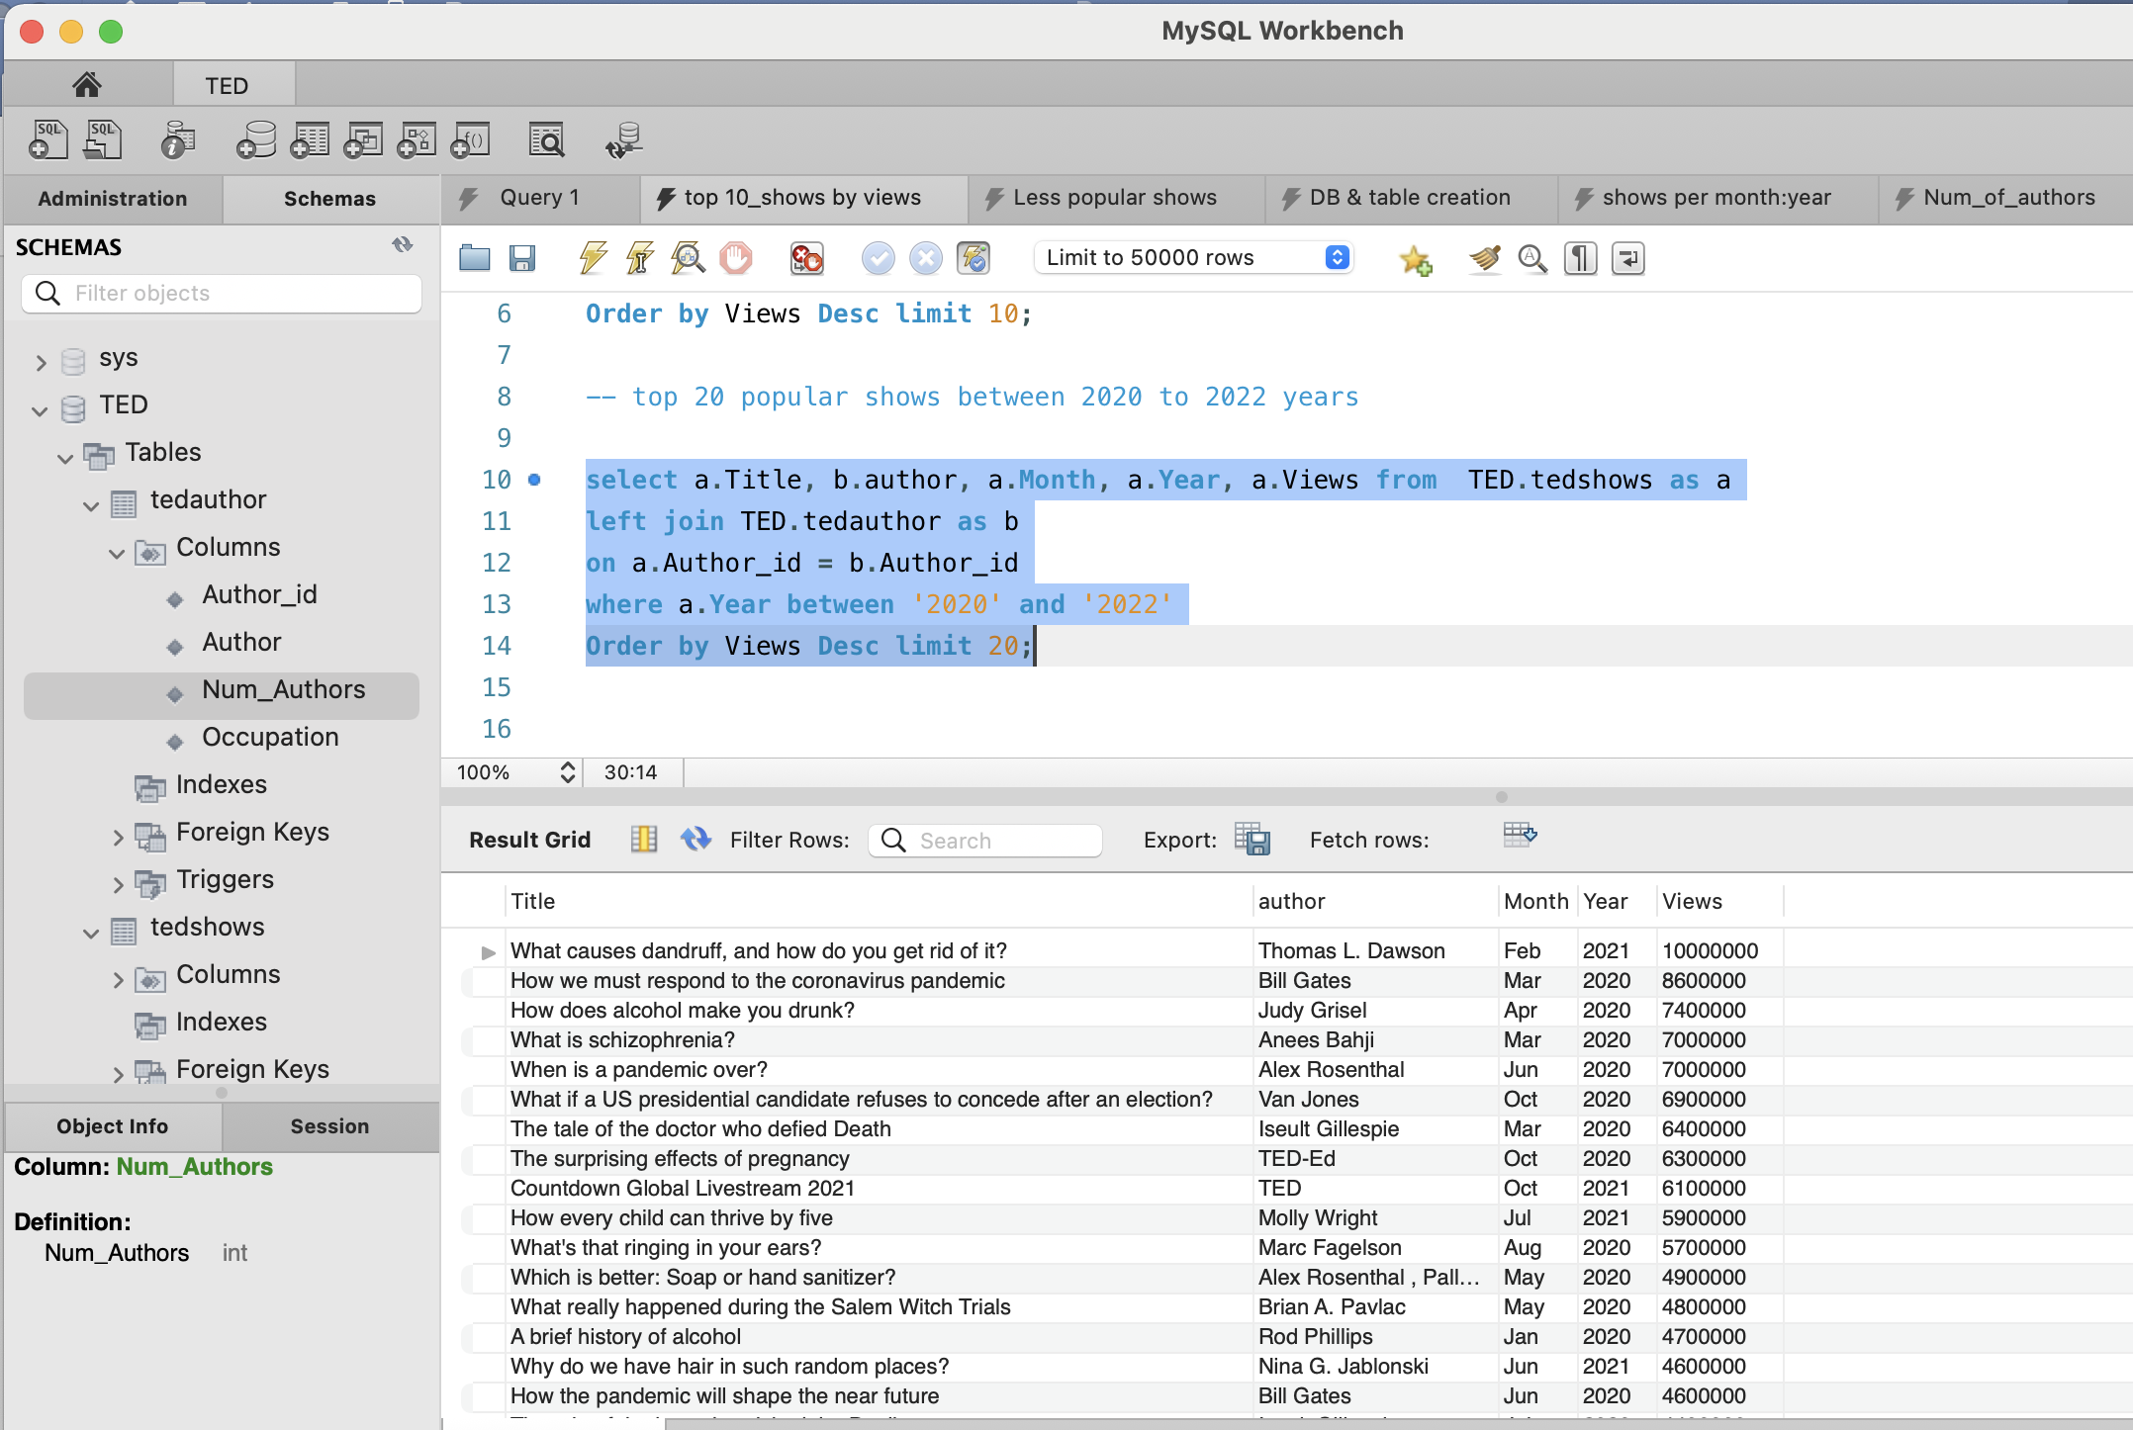
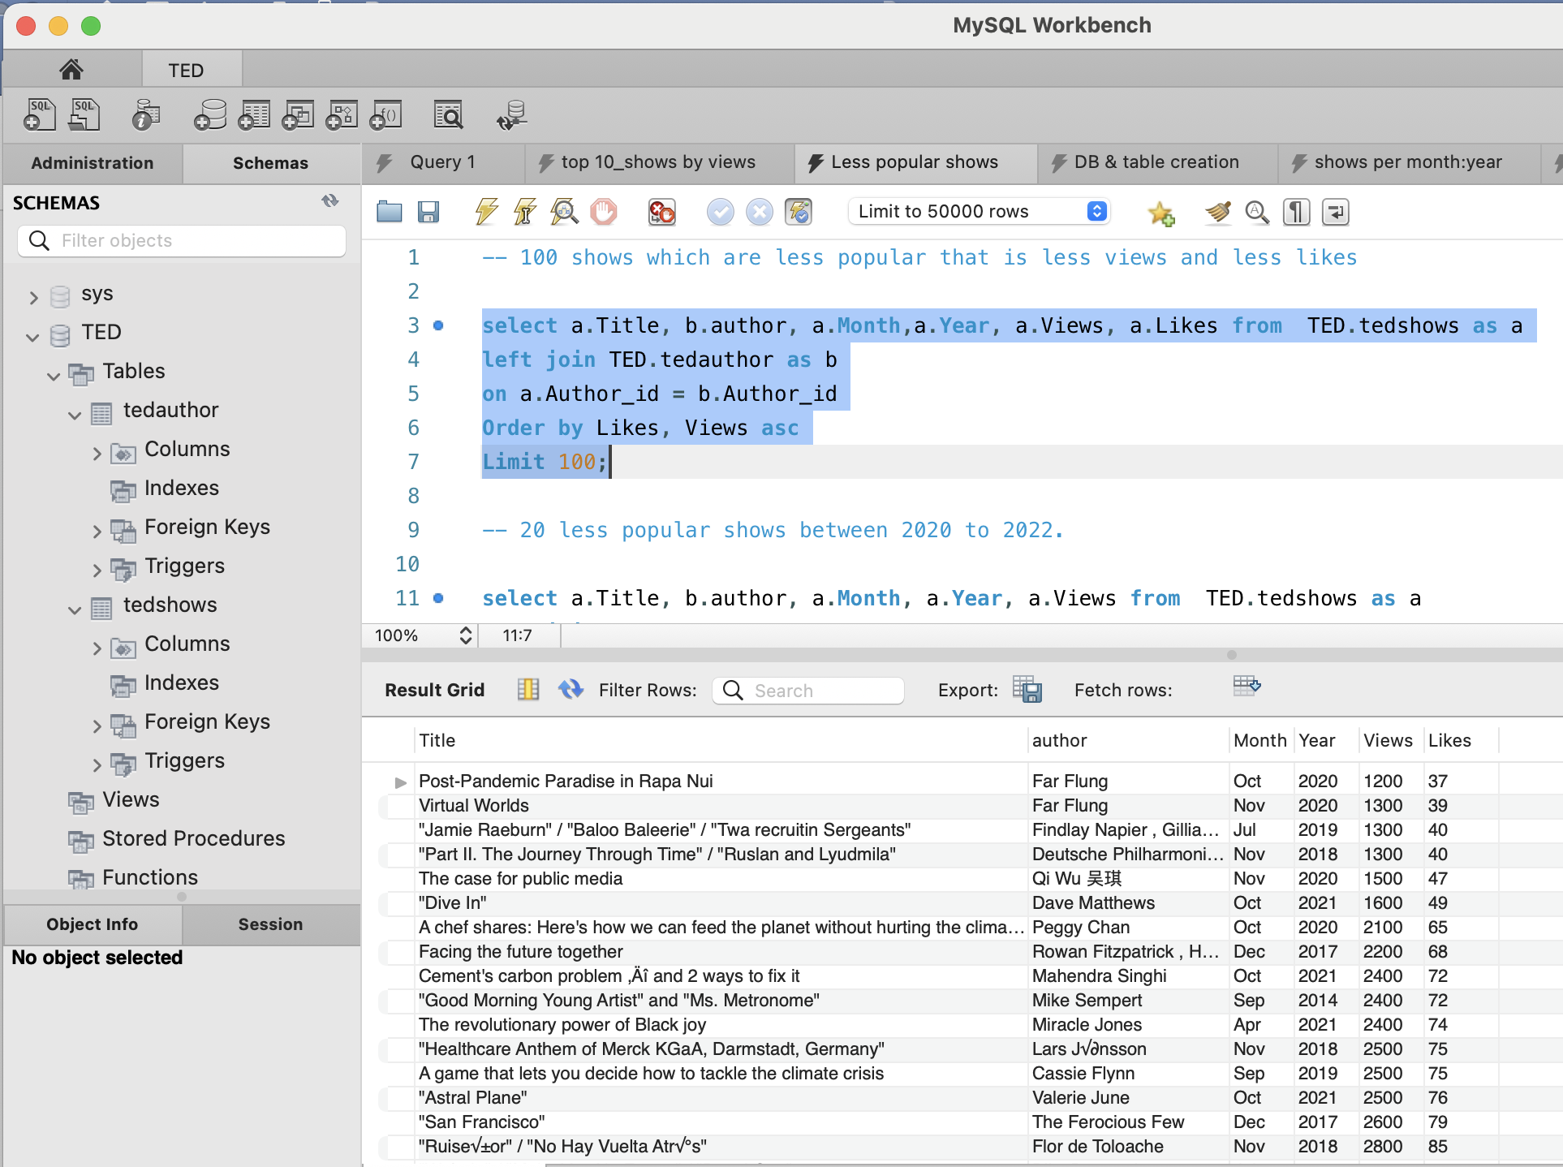
SQL QUERIES (Contin..)

Slide 18
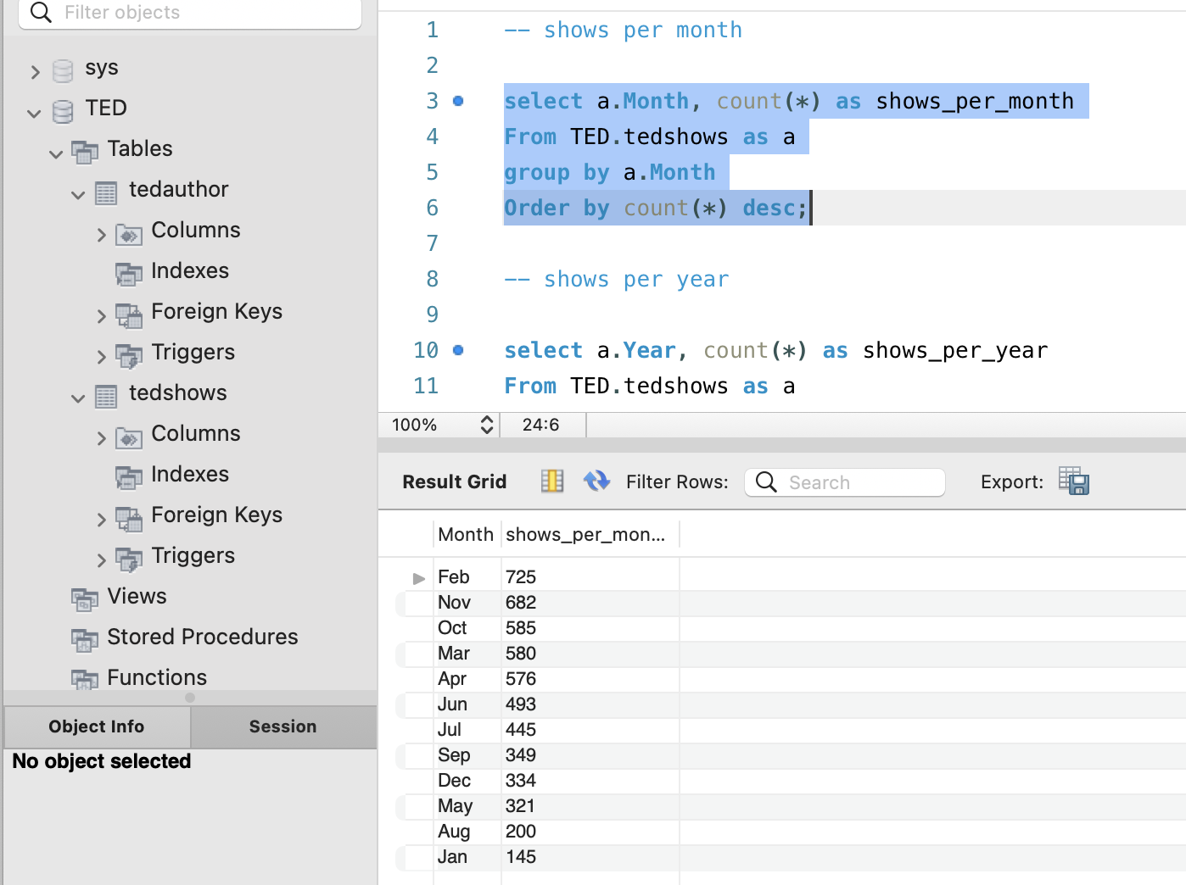
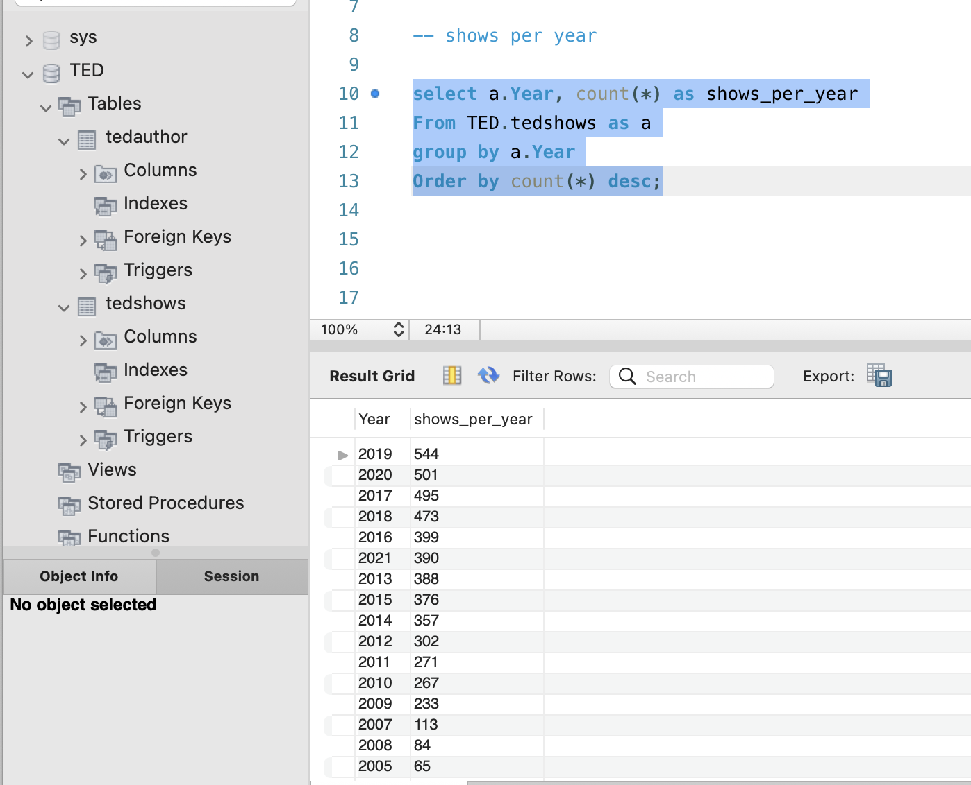
SQL QUERIES (Contin..)

Slide 19
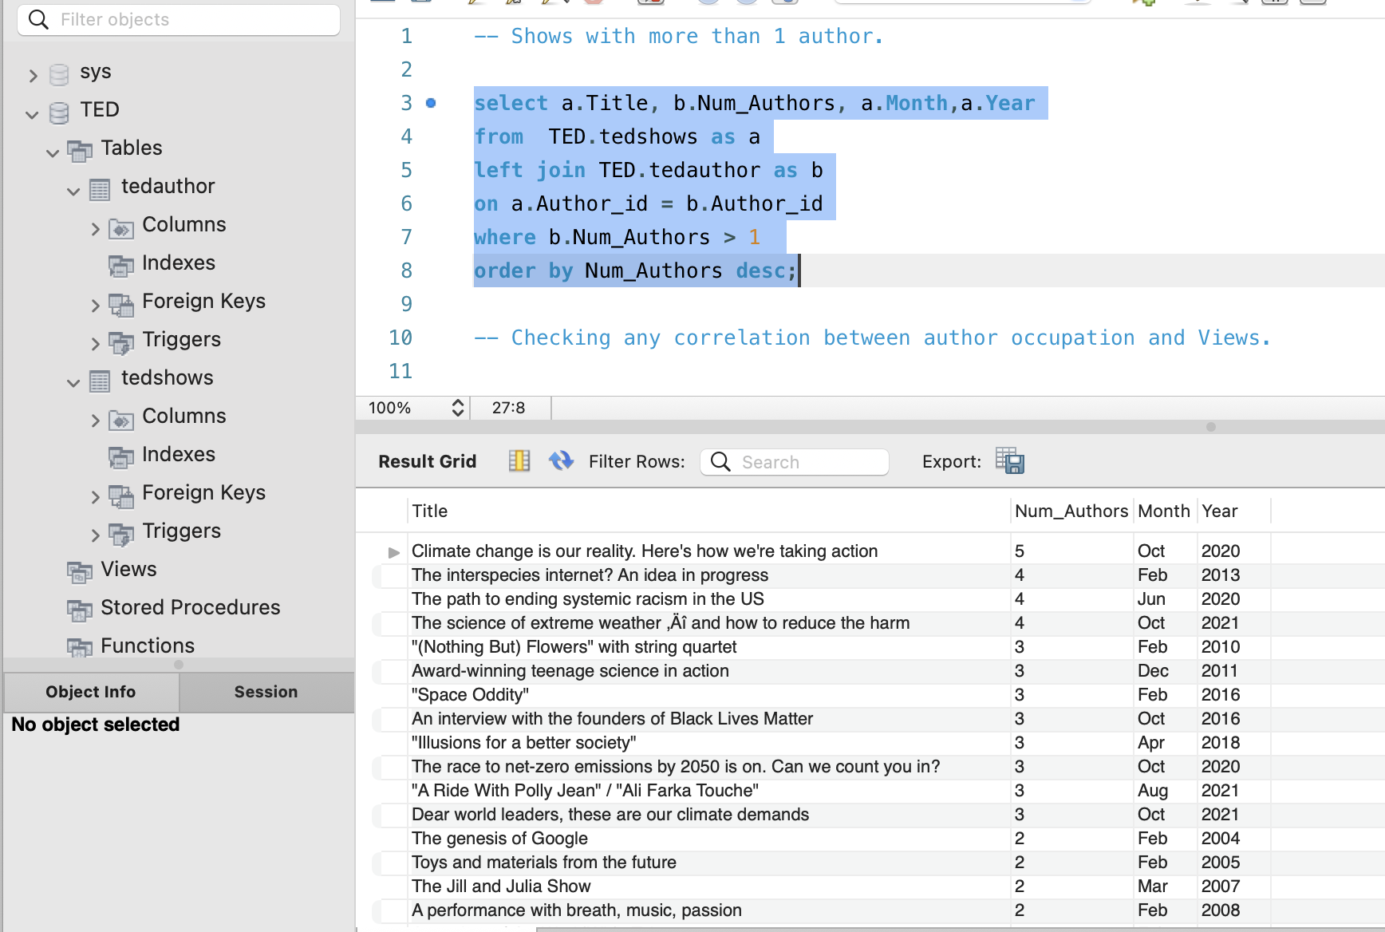
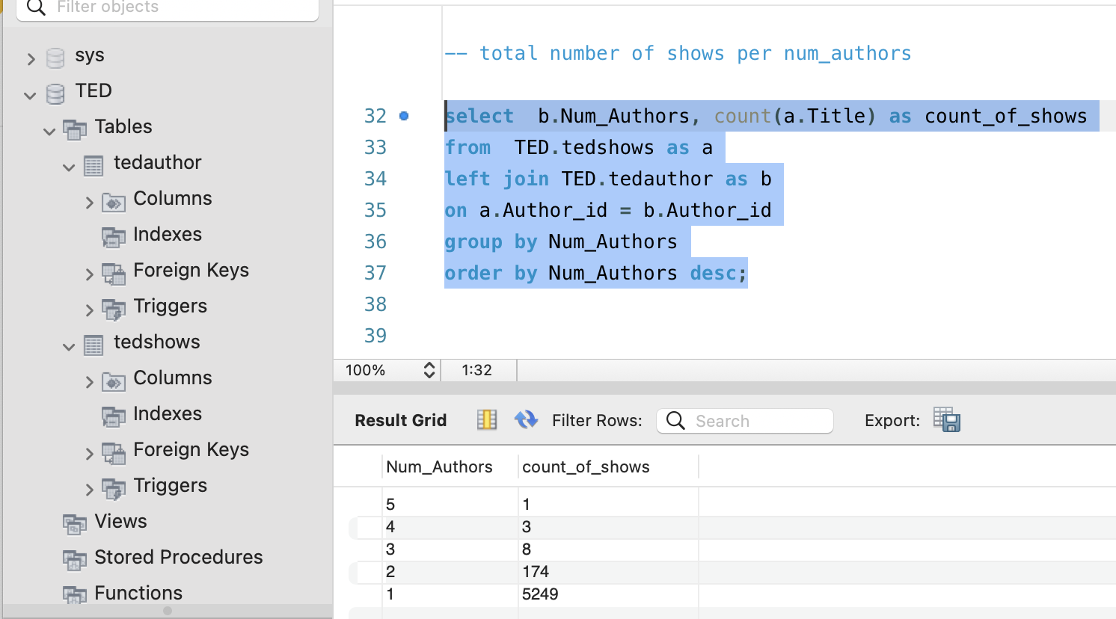
SQL QUERIES (Contin..)

Slide 20
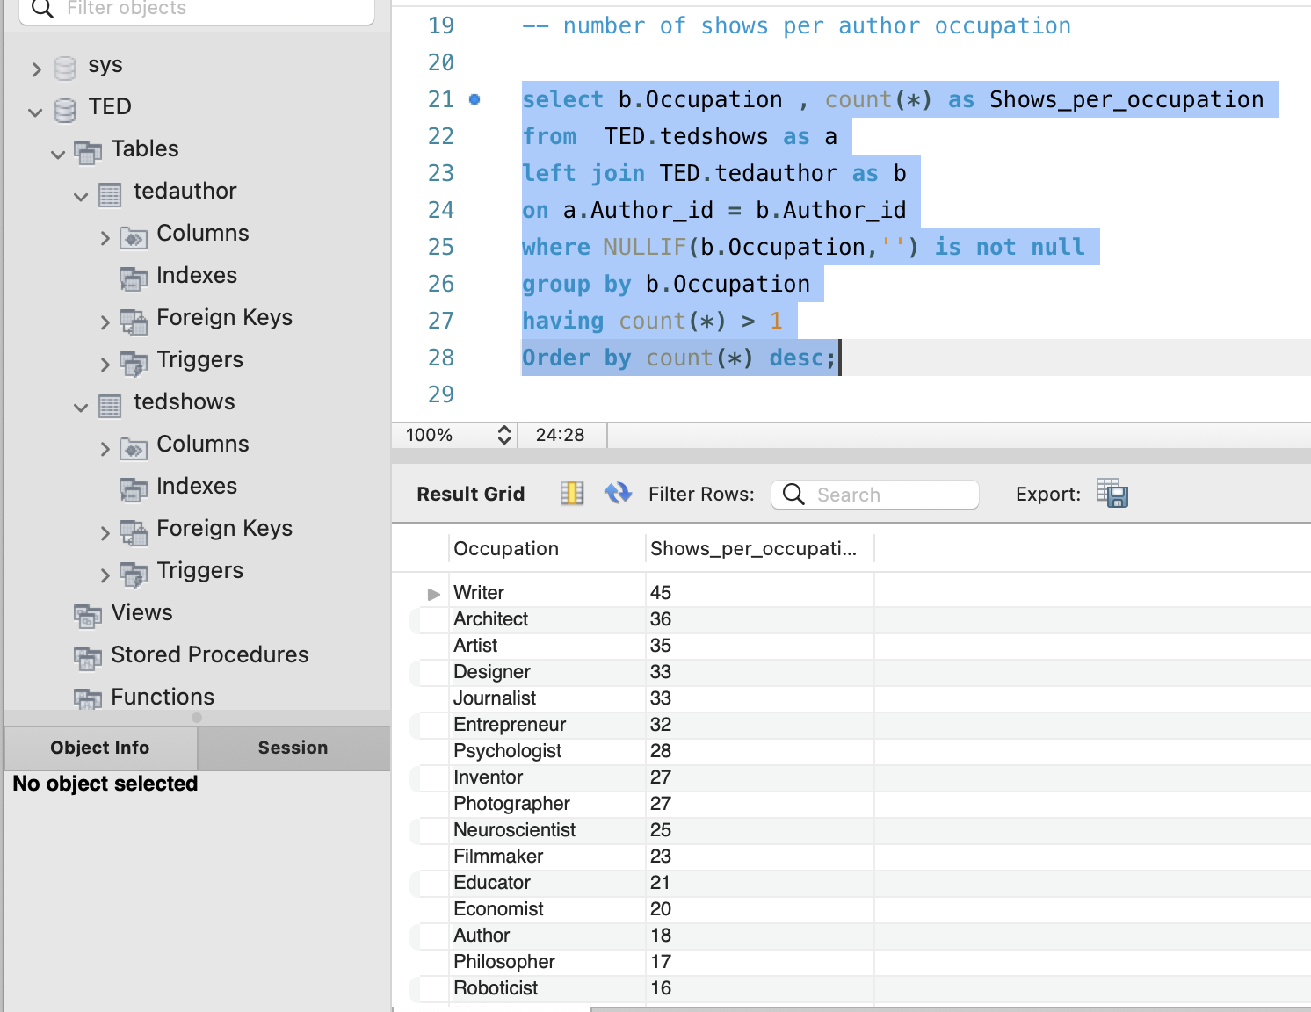
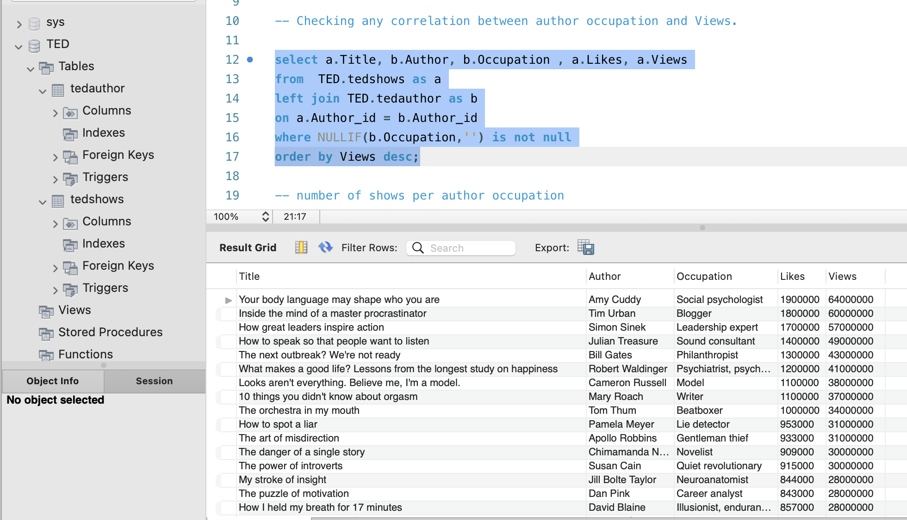
SQL QUERIES (Contin..)

Slide 21
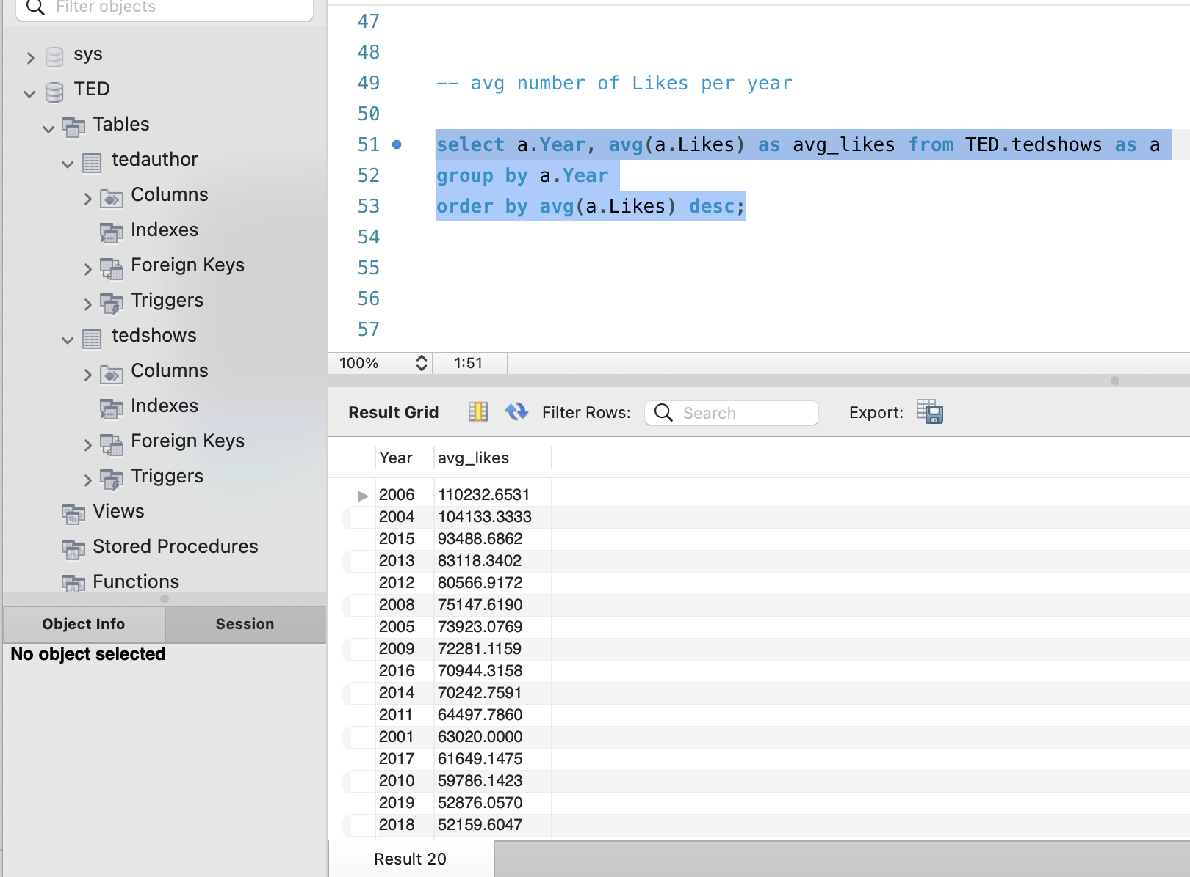
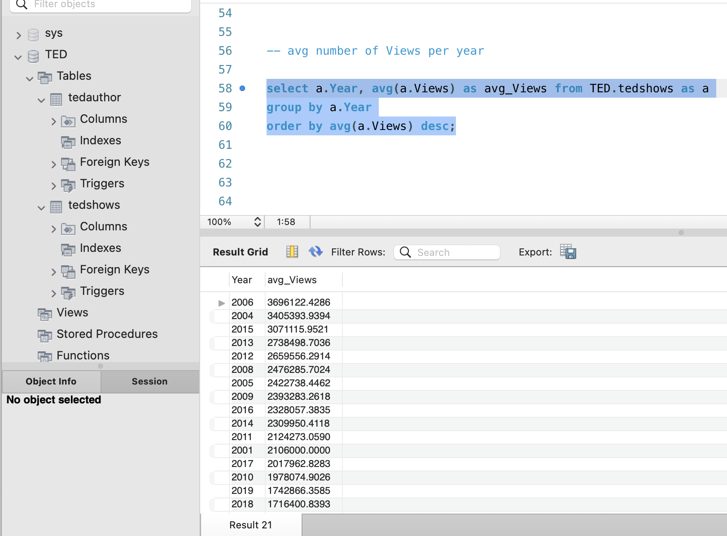
SQL QUERIES (Contin..)

Slide 22
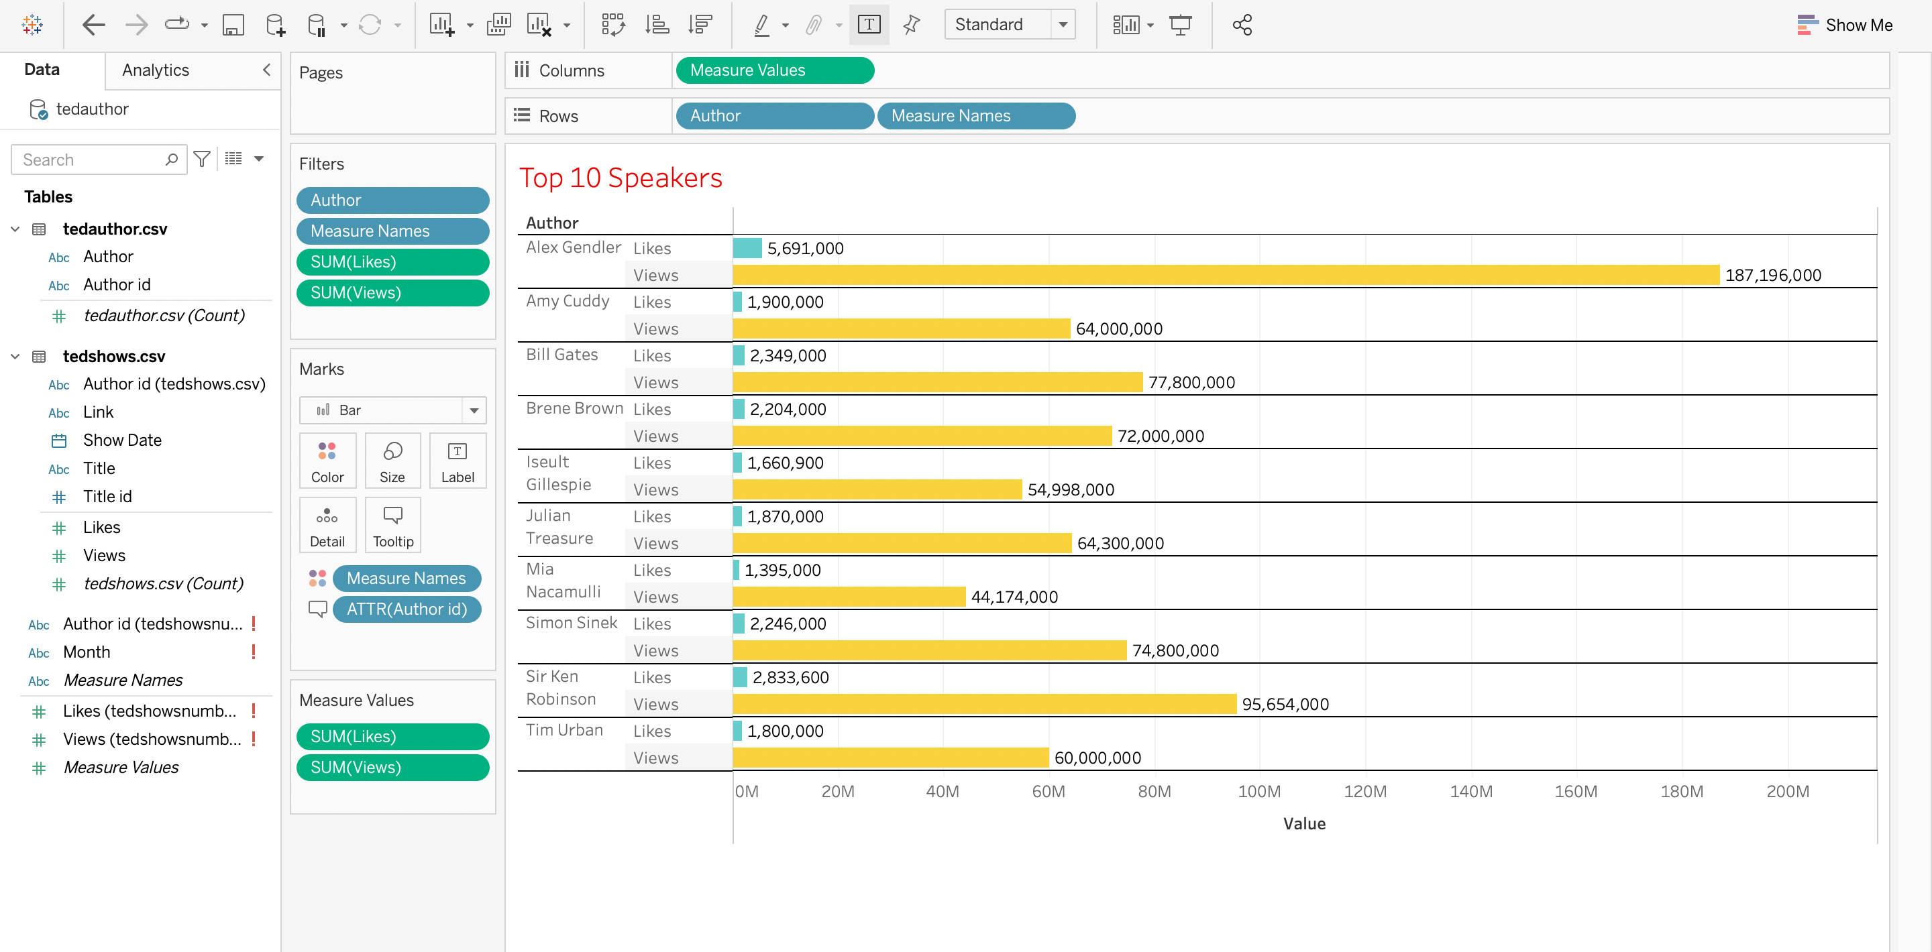
Tableau visualization
These are the top 10 speakers in terms of views & likes.

Slide 23
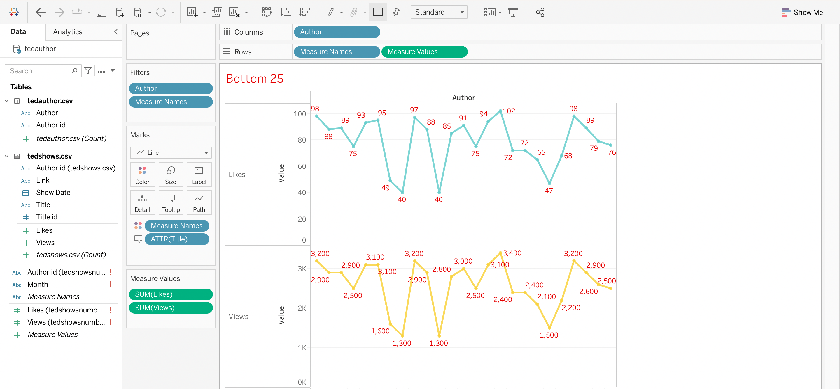
Bottom 25 speakers

Slide 24
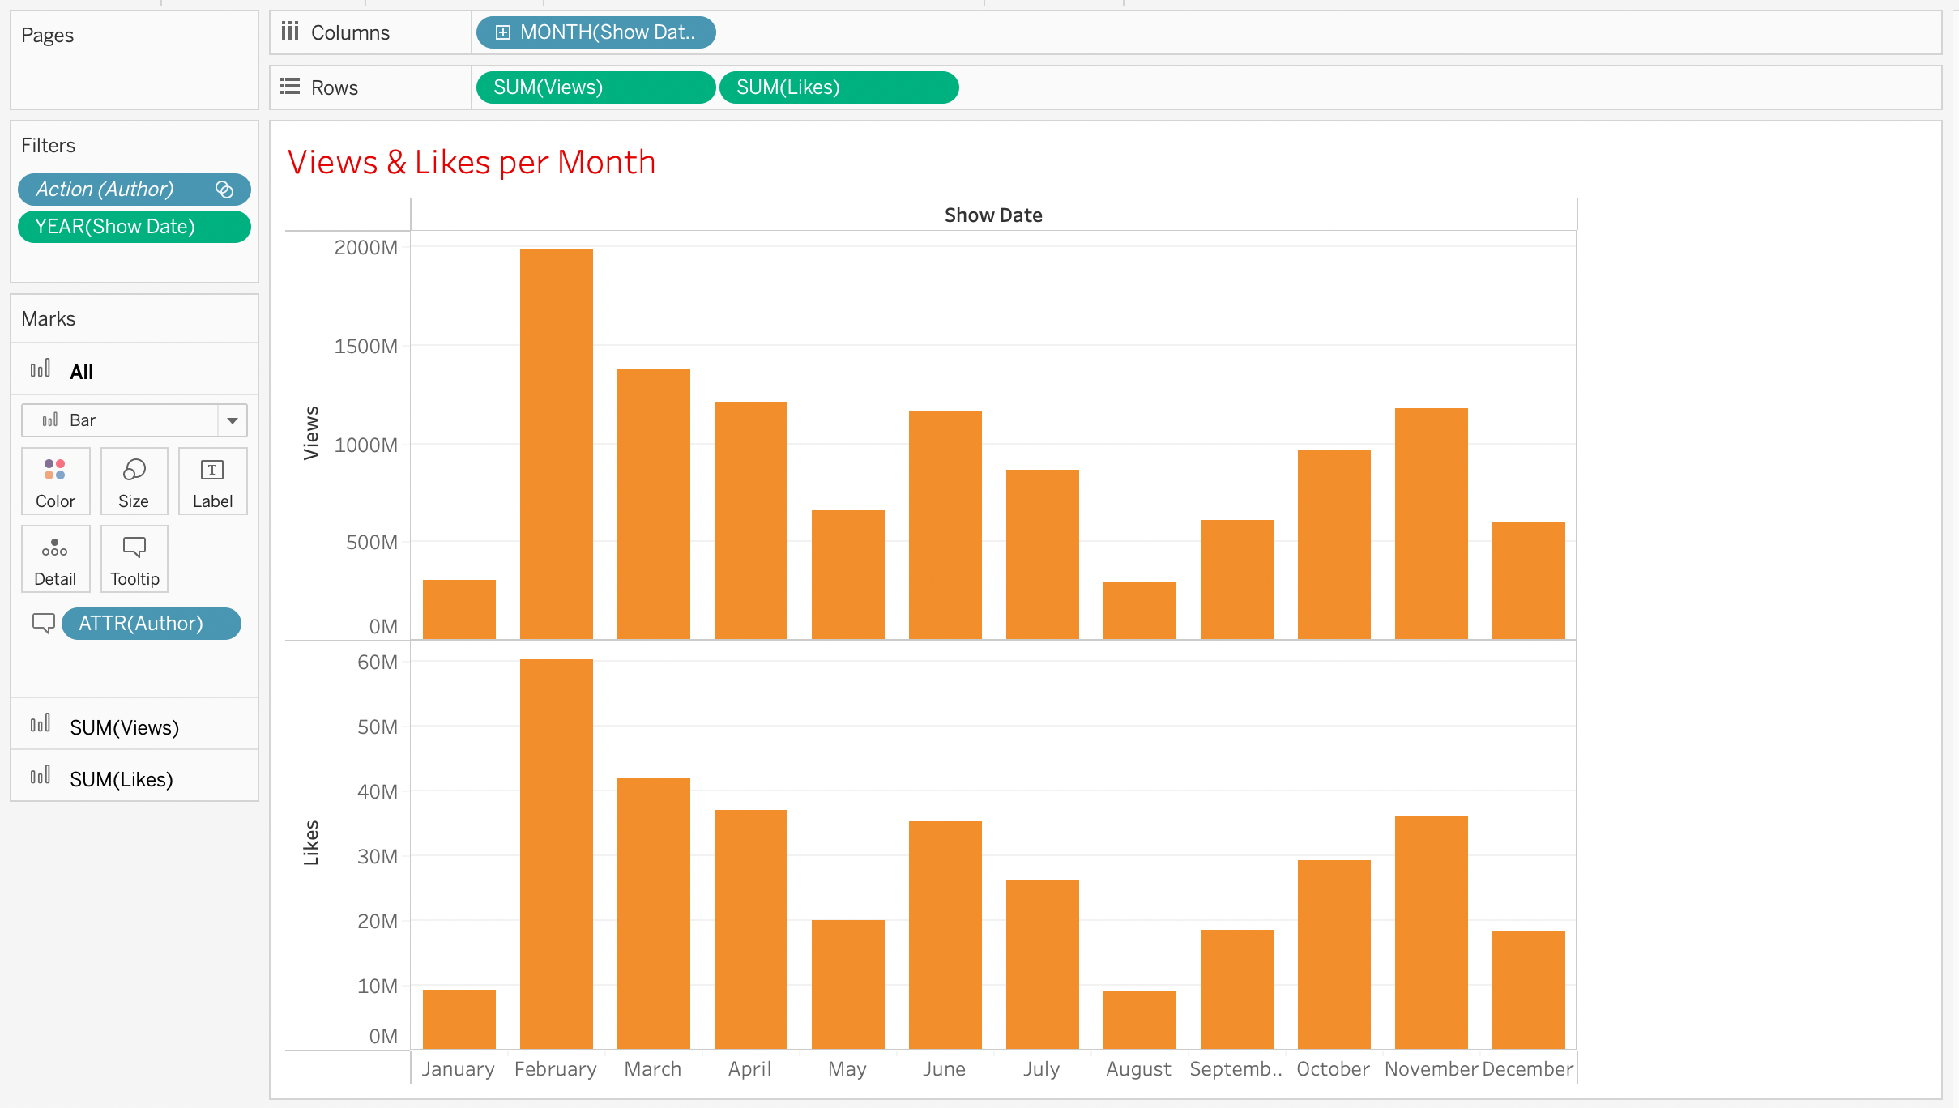
Views & Likes per month

Slide 25
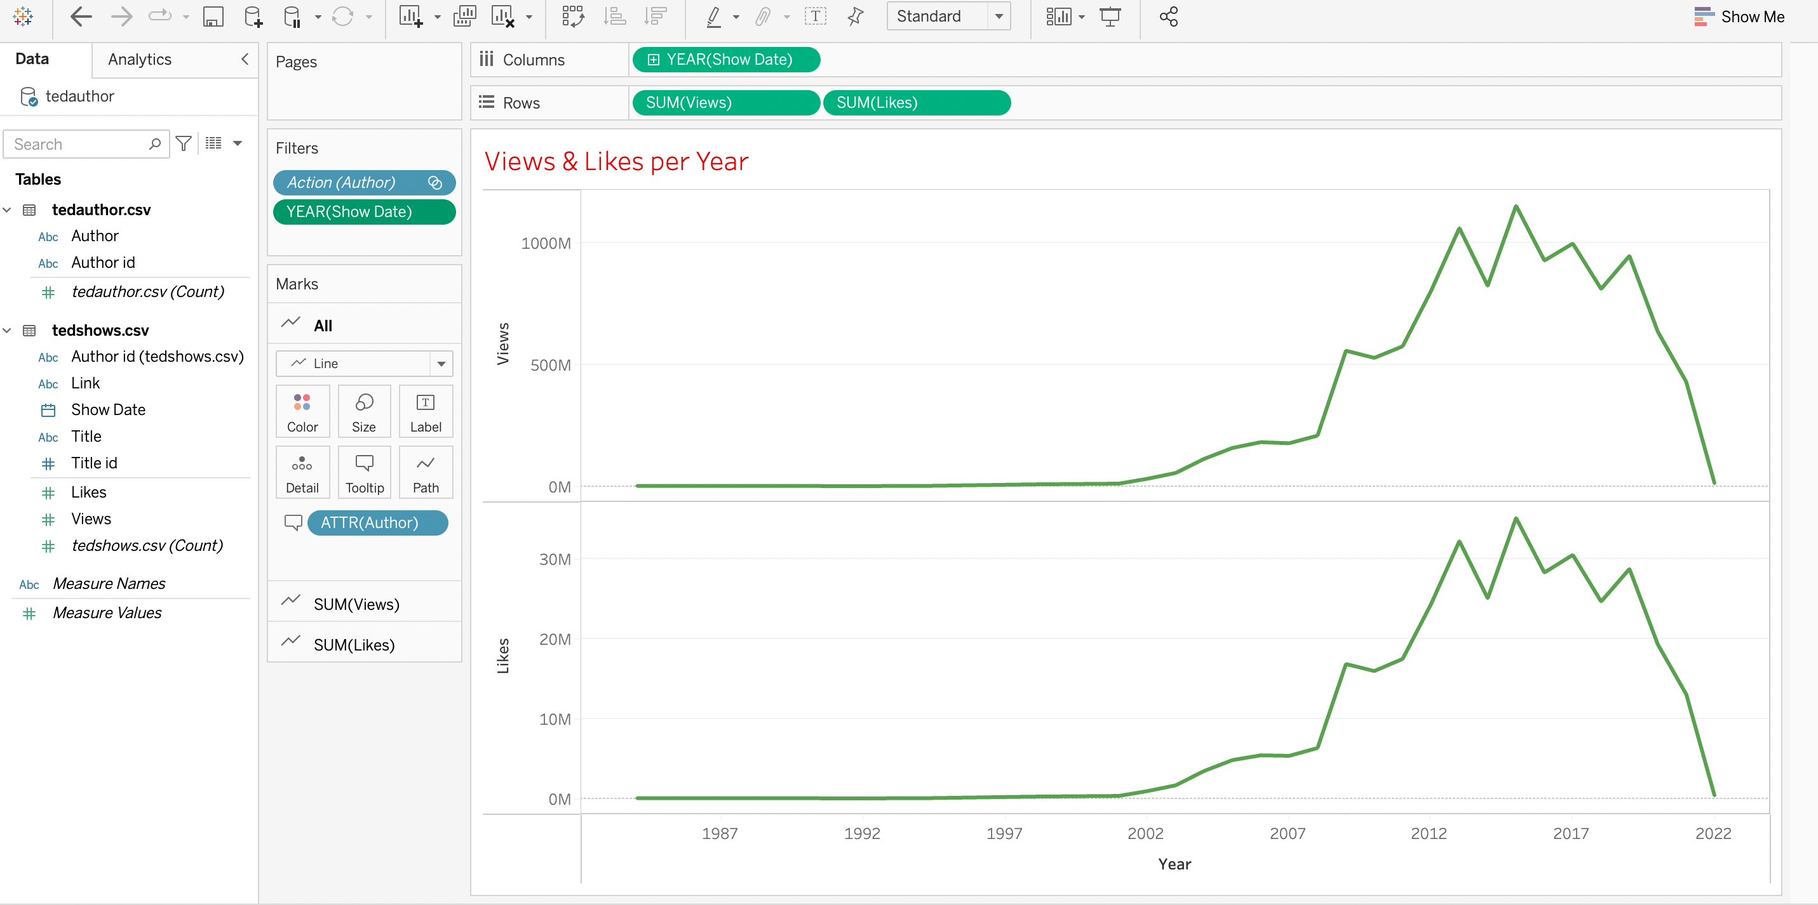
Views & Likes per Year

Slide 26
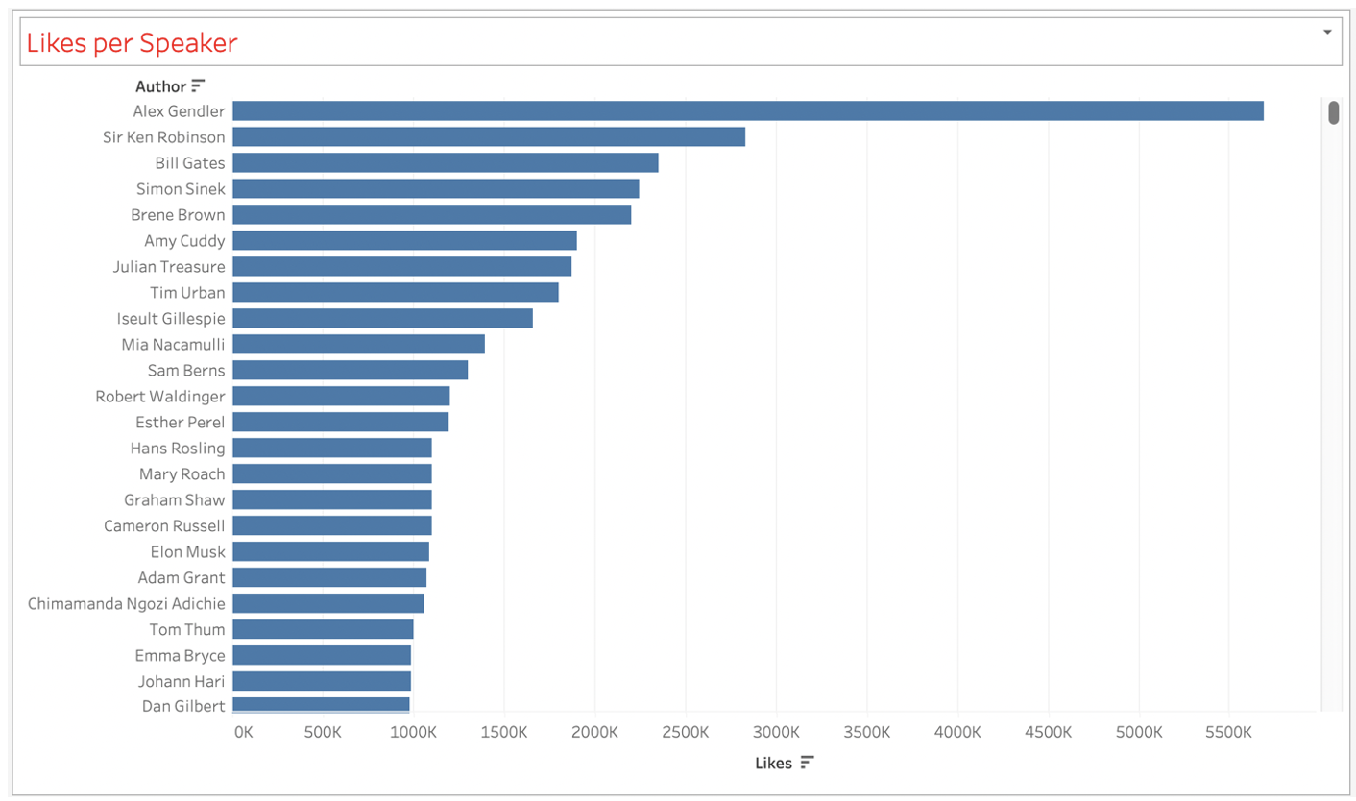
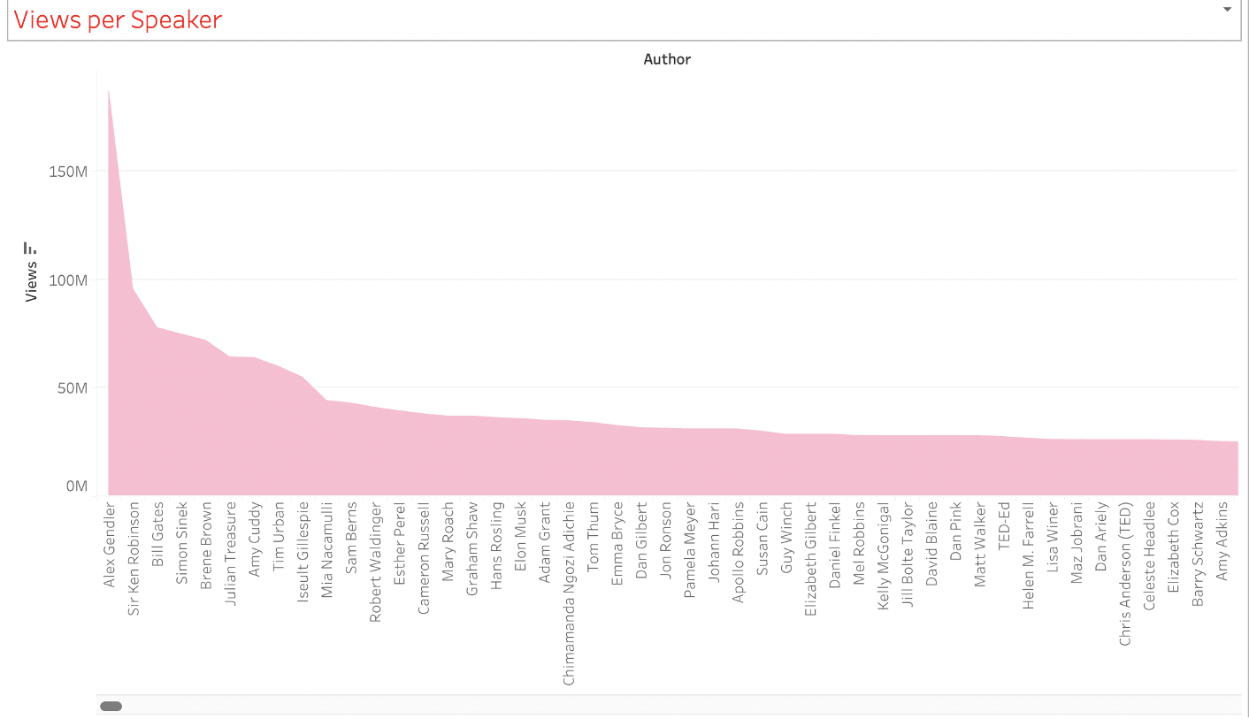
Likes per speaker Views Per Speaker

Slide 27
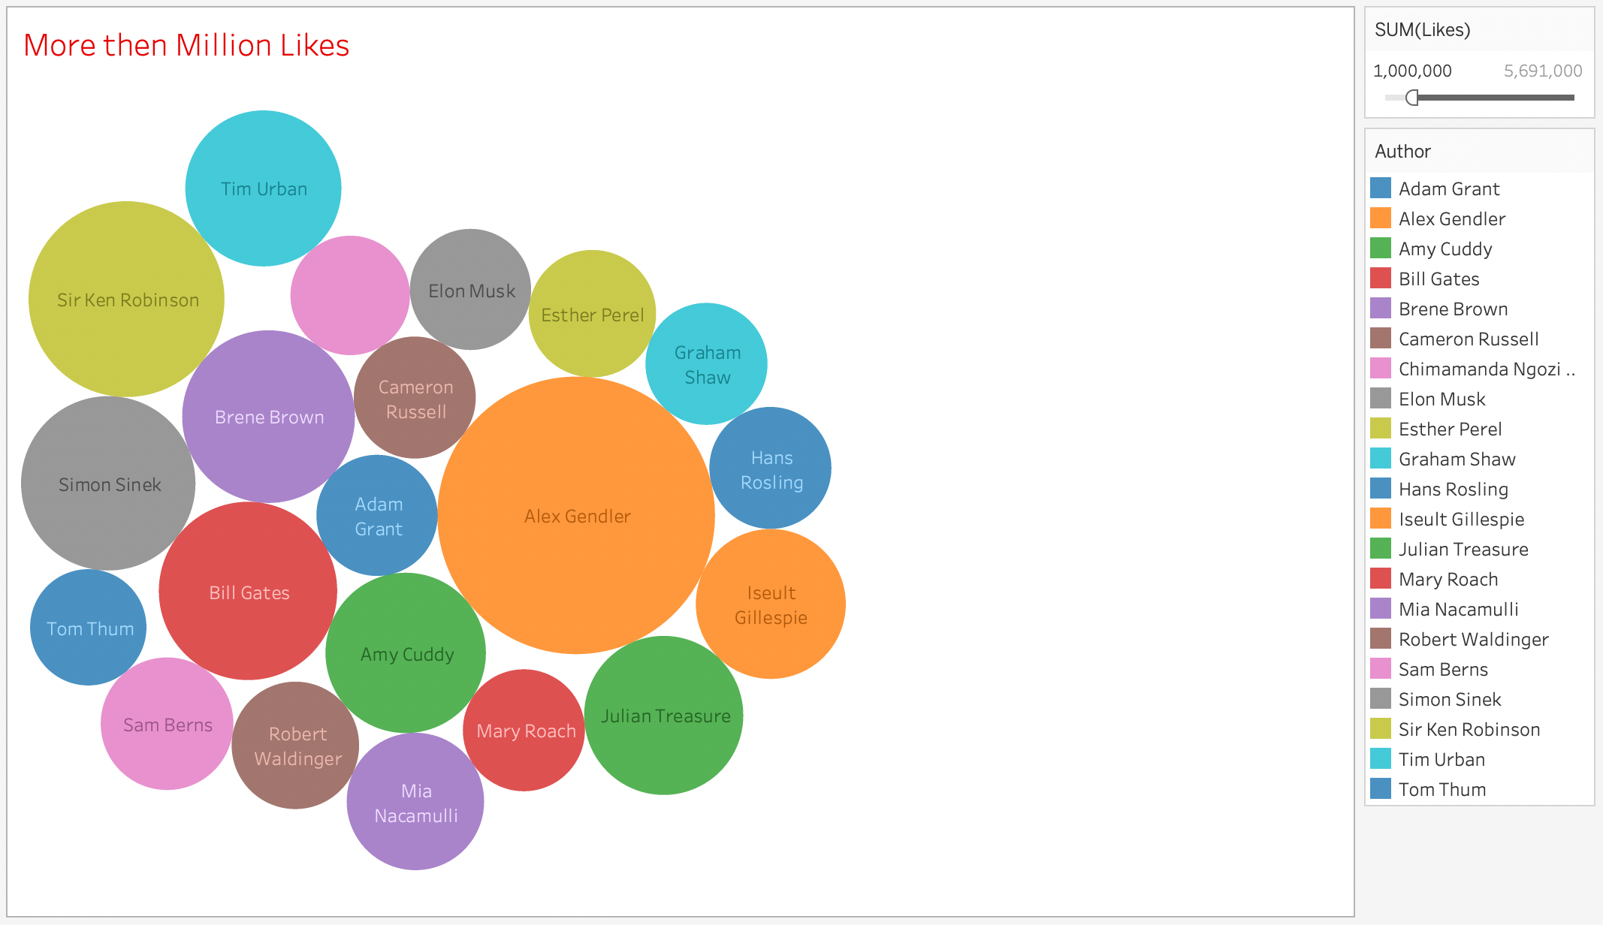
Speakers with More than million likes

Slide 28
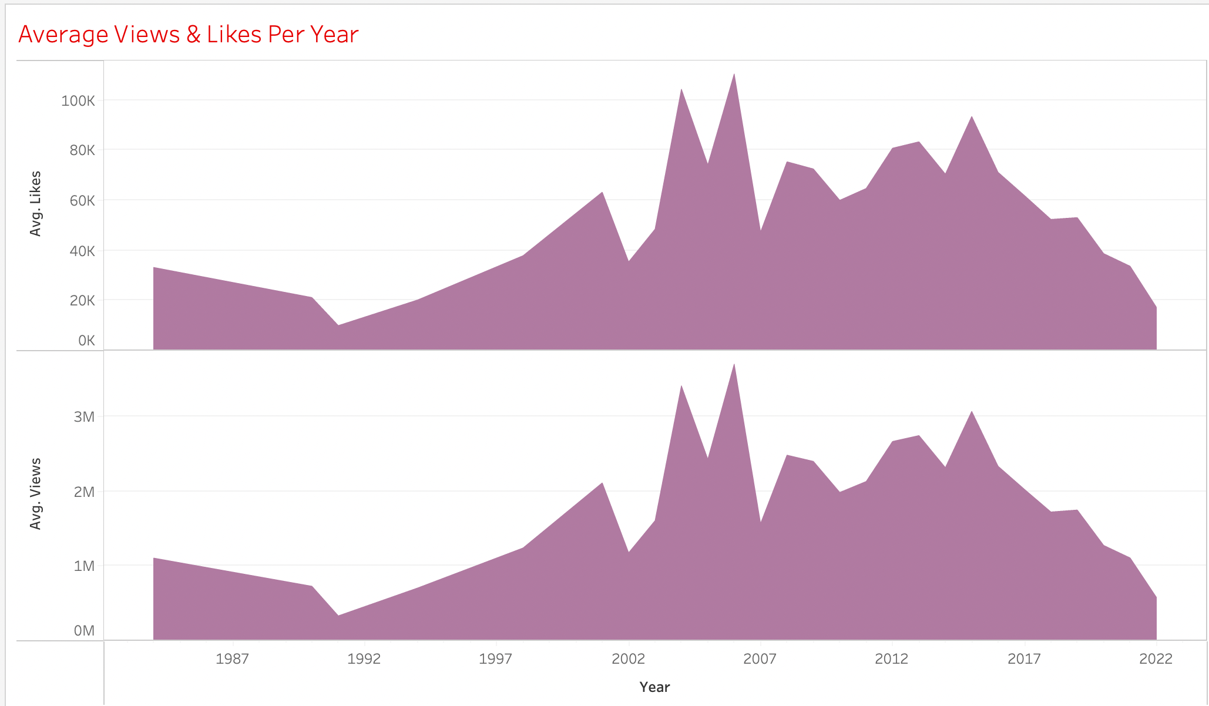
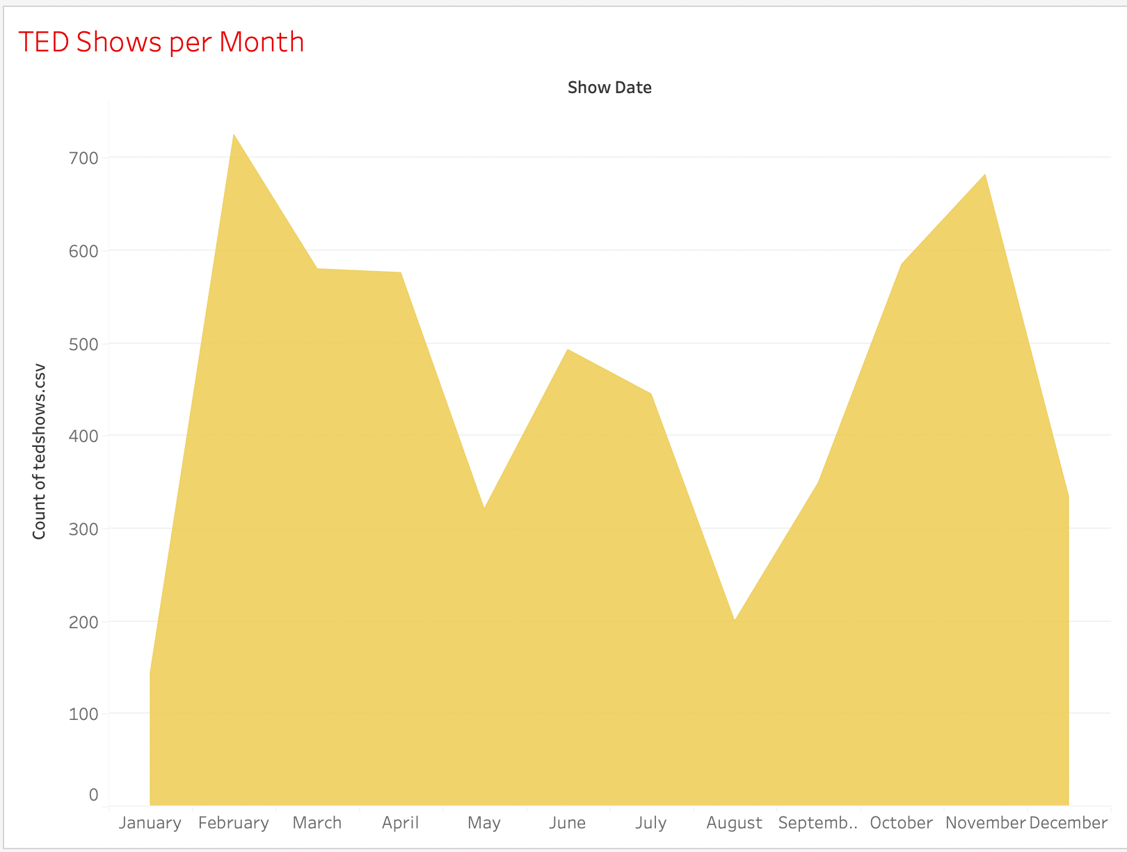
AVG LIKES & VIEWs Per YEAR
Number of Shows per month

Slide 29
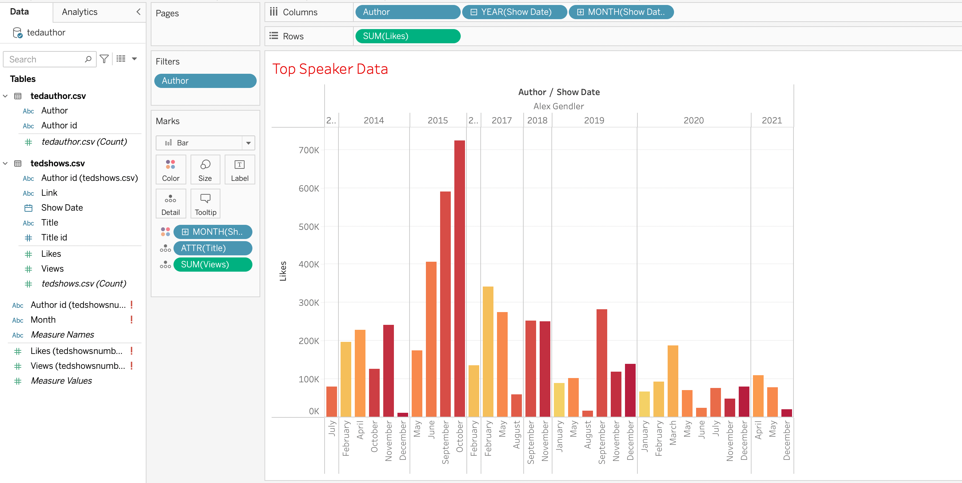
Number one speaker

Slide 30
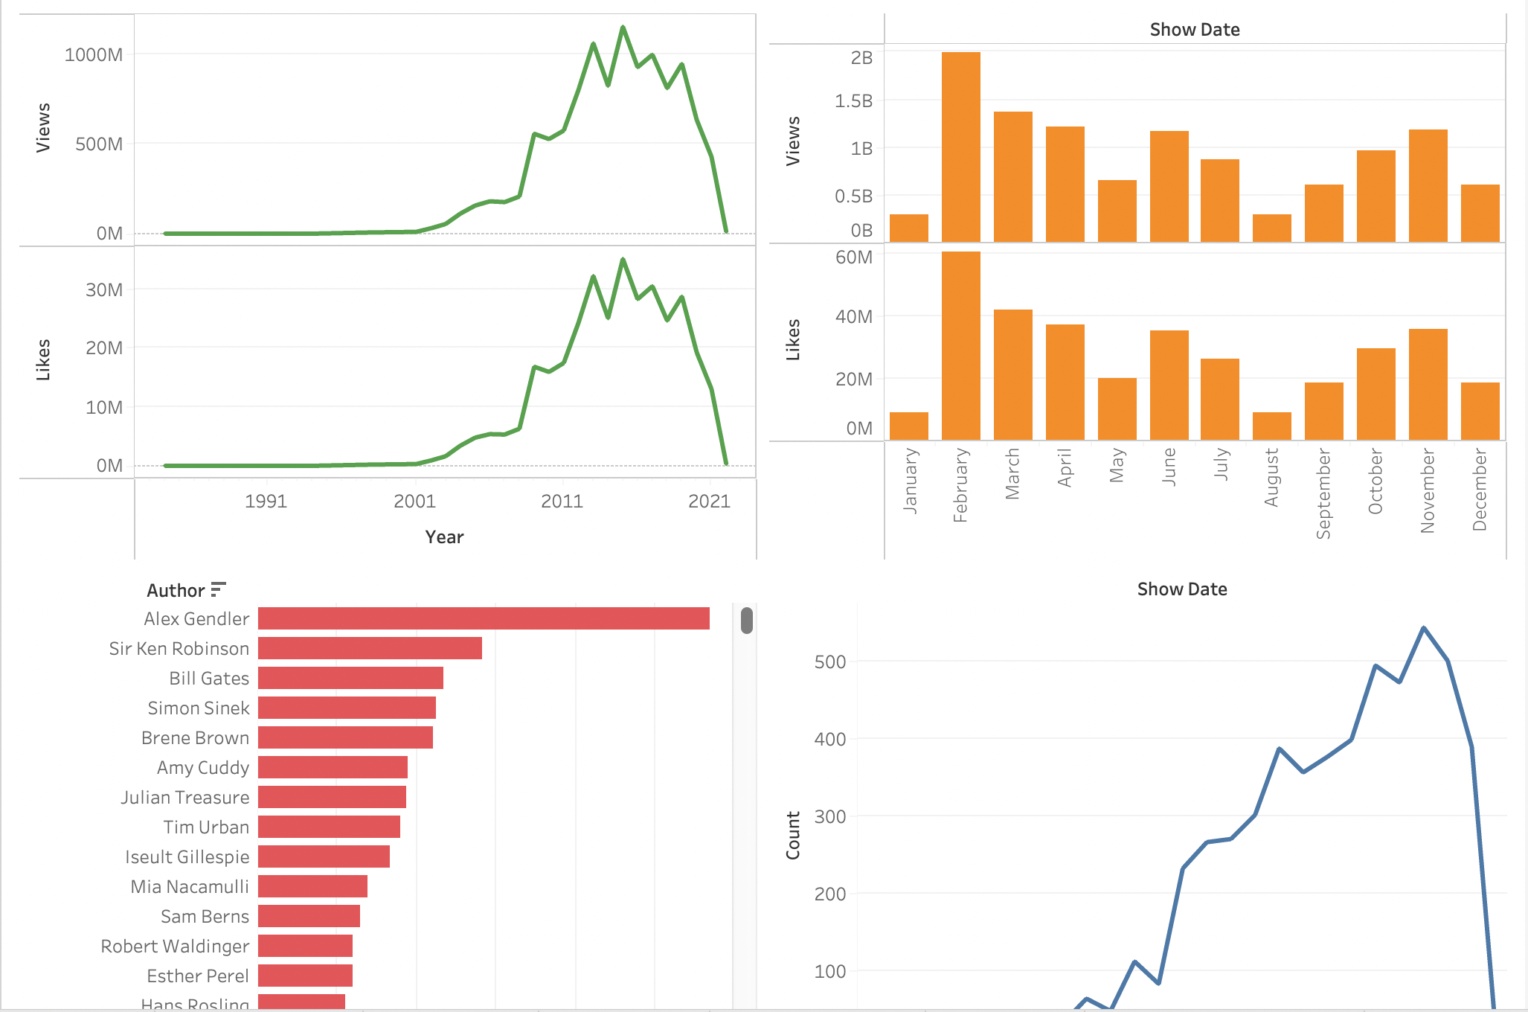
Dashboard

Slide 31

Summary
Alex gendler has the greatest number of views & likes than any other author in the period from Feb. 1984 to Feb. 2022 (i.e, performed 45 shows with 187,196,000 Views and 5,691,000 Likes).
The greatest number of views is recorded in the month of April 2017 (340,630,000 Views).
Highest number of shows is recorded in Feb Month (725 shows).
Highest number of shows is recorded in 2019 year (544 shows).
Average number of Views and Likes are more in the year 2006.
Every year between Feb and April, the shows have received the highest interest from audience.
It is safe to assume from our analysis that the number of people watching ted talks has decreased gradually since April 2019.

Slide 32


Slide 33

Thank you

